Slide 1
ELEMENTARY COMBINATORICS & PROBABILITY
Lecture 5
Pigeonhole principle, review

Slide 2
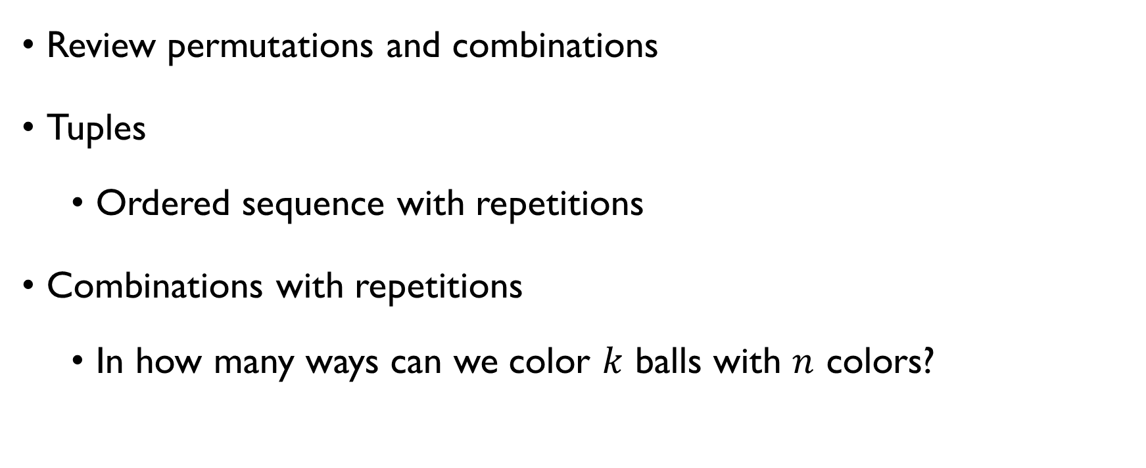
Last time
Review permutations and combinations
Tuples
Ordered sequence with repetitions
Combinations with repetitions
In how many ways can we color $k$ balls with $n$ colors?

Slide 3
today
Problem set 4
Permutations, combinations, tuples, …
Pigeonhole principle
Problem set 5

Slide 4
Graded assignment 2 is out
Deadline: Monday, March 22, 23:59 Barcelona time
See Google classroom

Slide 5
review

Slide 6
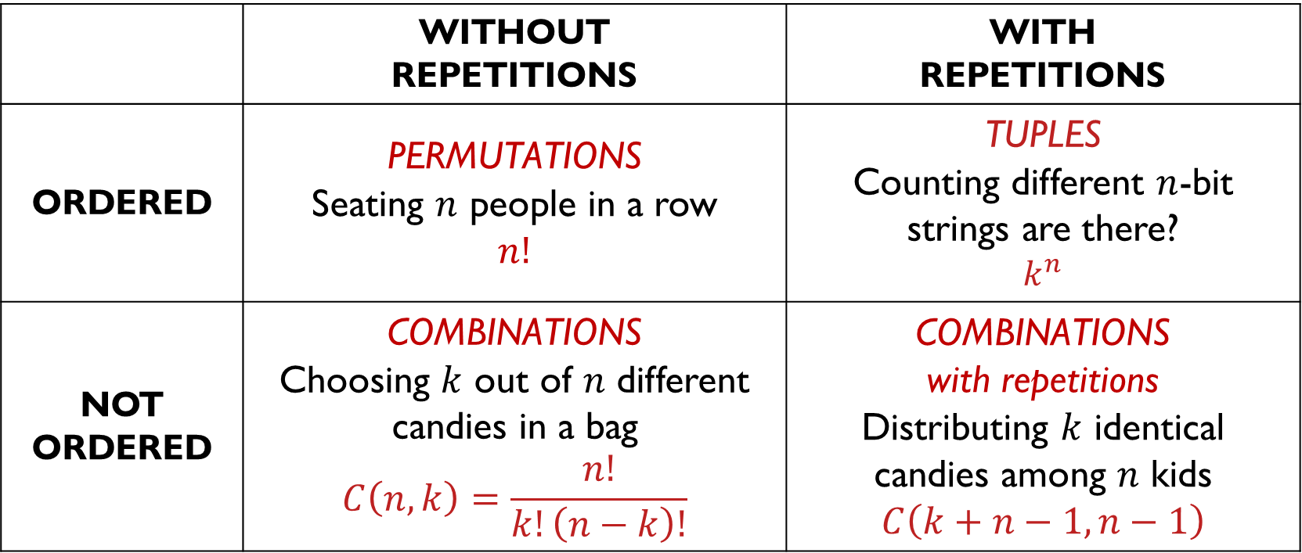
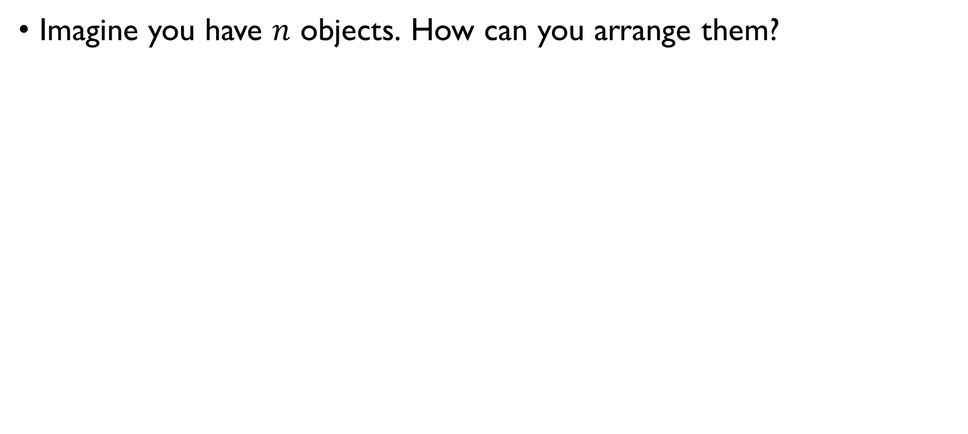
Different arrangements
Imagine you have $n$ objects. How can you arrange them?
 | WITHOUT REPETITIONS | WITH REPETITIONS
ORDERED | PERMUTATIONS Seating $n$ people in a row $$n!$$ | TUPLES Counting different $n$-bit strings are there? $$k^{n}$$
NOT ORDERED | COMBINATIONS Choosing $k$ out of $n$ different candies in a bag $$C\left(n,k\right)=\frac{n!}{k!\left(n−k\right)!}$$ | COMBINATIONS with repetitions Distributing $k$ identical candies among $n$ kids $$C\left(k+n−1, n−1\right)$$

Slide 7
Combinations with repetitions
How many ways are there to place 4 colored balls in a bag, when each ball should be either Red, Green, or Blue?

Slide 8
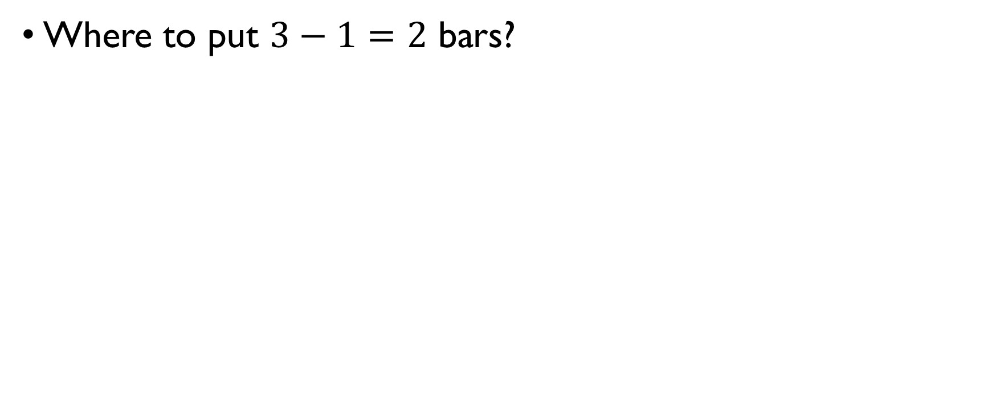
Combinations with repetitions
Where to put $3−1=2$ bars?
$$C\left(4+3−1, 3−1\right)=C\left(6,2\right)=\frac{6!}{2!4!}=15$$
* * * * * *

Slide 9
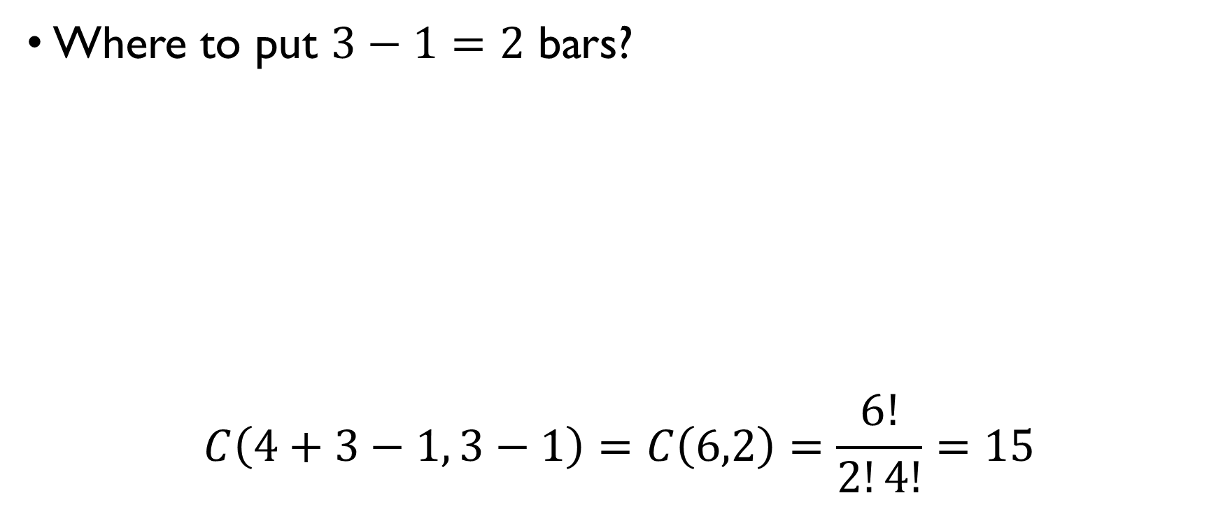
Combinations with repetitions
Where to put $3−1=2$ bars?
$$C\left(4+3−1, 3−1\right)=C\left(6,2\right)=\frac{6!}{2!4!}=15$$
* * * * * *

Slide 10
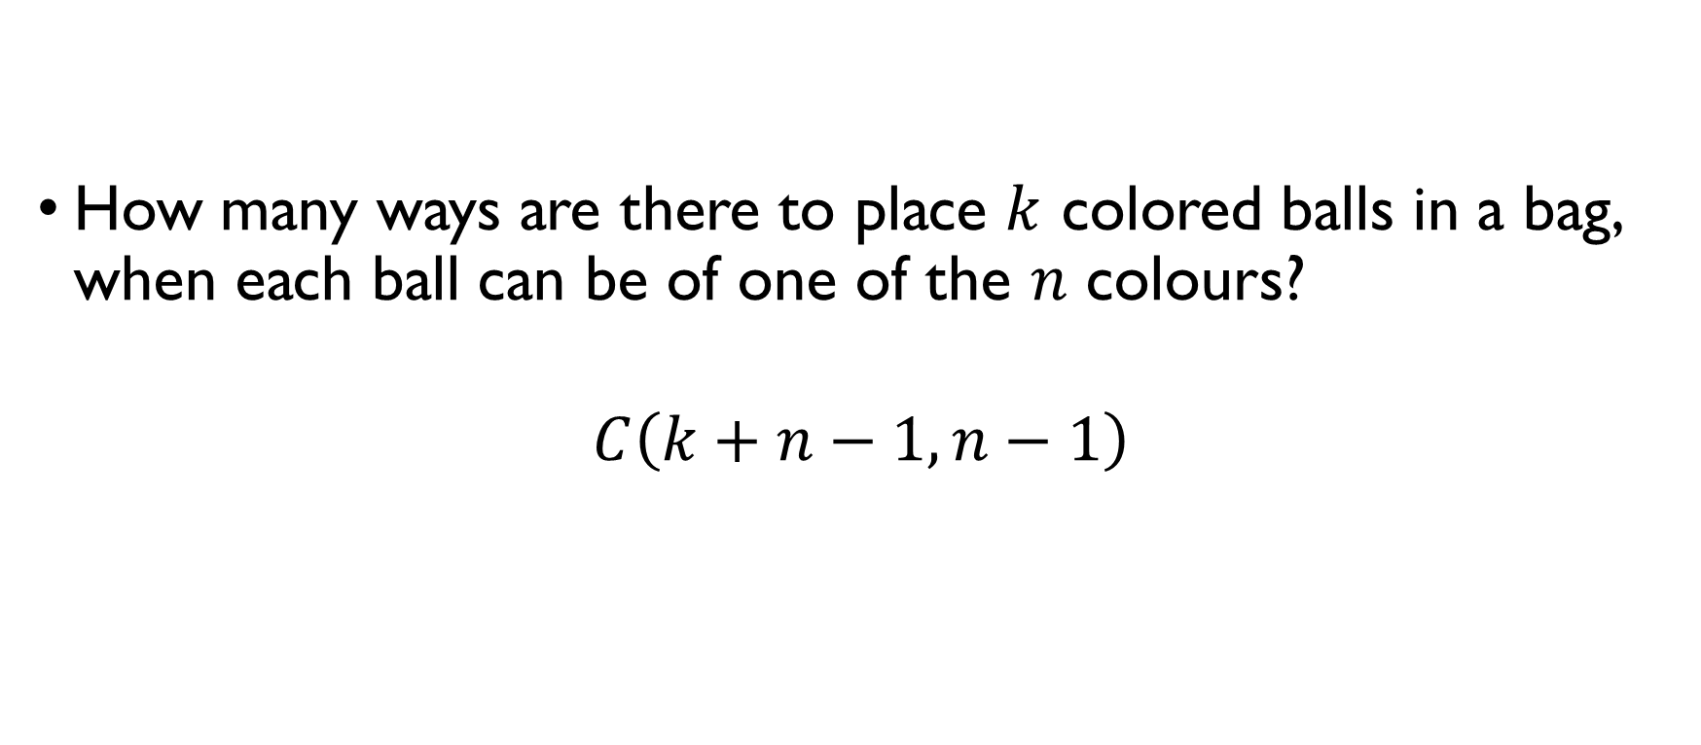
Combinations with repetitions
How many ways are there to place $k$ colored balls in a bag, when each ball can be of one of the $n$ colours?
$$C\left(k+n−1,n−1\right)$$

Slide 11
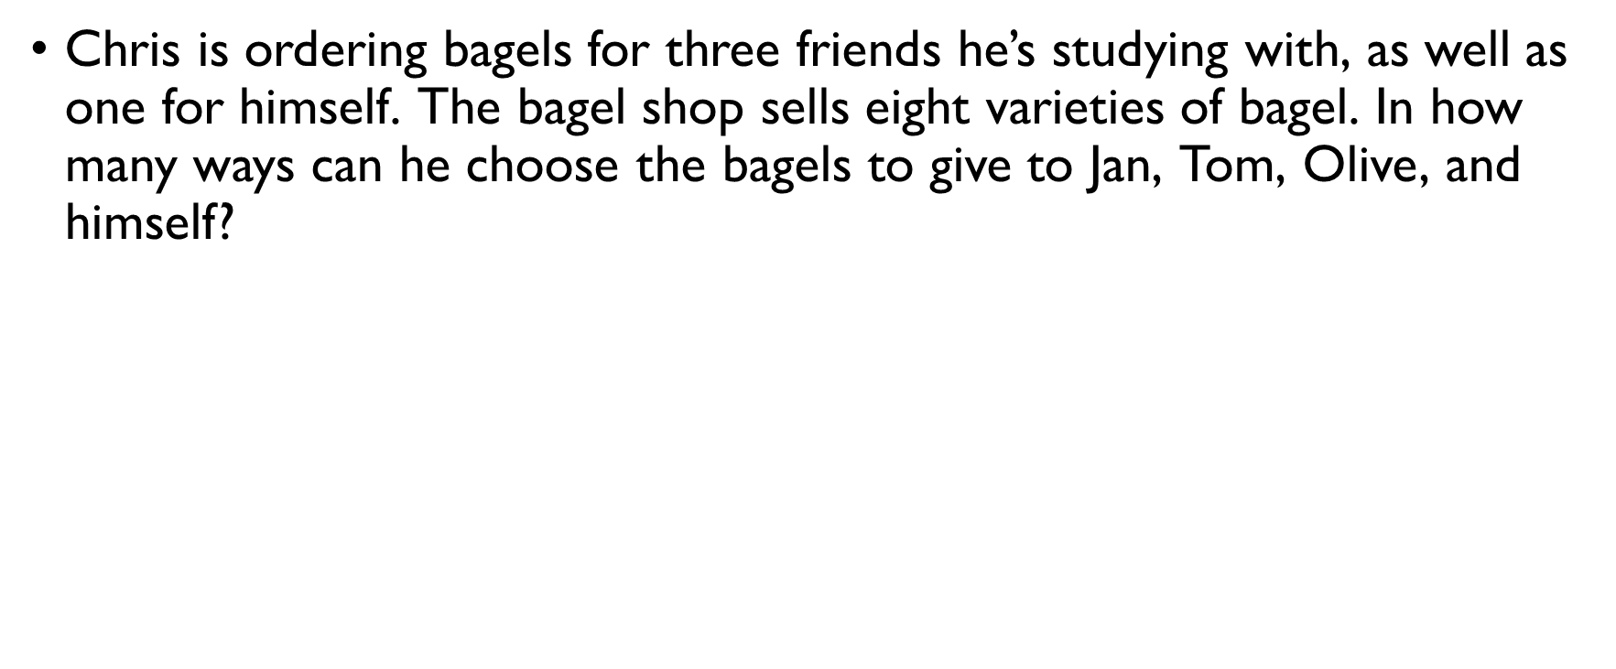
bagels
Chris is ordering bagels for three friends he’s studying with, as well as one for himself. The bagel shop sells eight varieties of bagel. In how many ways can he choose the bagels to give to Jan, Tom, Olive, and himself? It matters who gets which bagel $→$ ordered arrangement. Repetitions allowed.
$8⋅8⋅8⋅8=8^{4}$ ways to choose the bagels

Slide 12
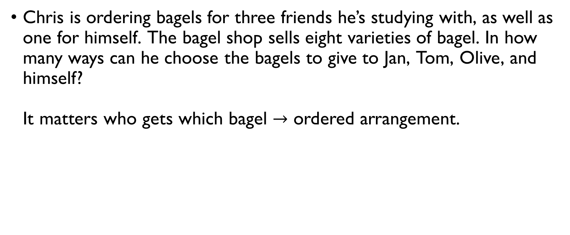
bagels
Chris is ordering bagels for three friends he’s studying with, as well as one for himself. The bagel shop sells eight varieties of bagel. In how many ways can he choose the bagels to give to Jan, Tom, Olive, and himself? It matters who gets which bagel $→$ ordered arrangement. Repetitions allowed.
$8⋅8⋅8⋅8=8^{4}$ ways to choose the bagels

Slide 13
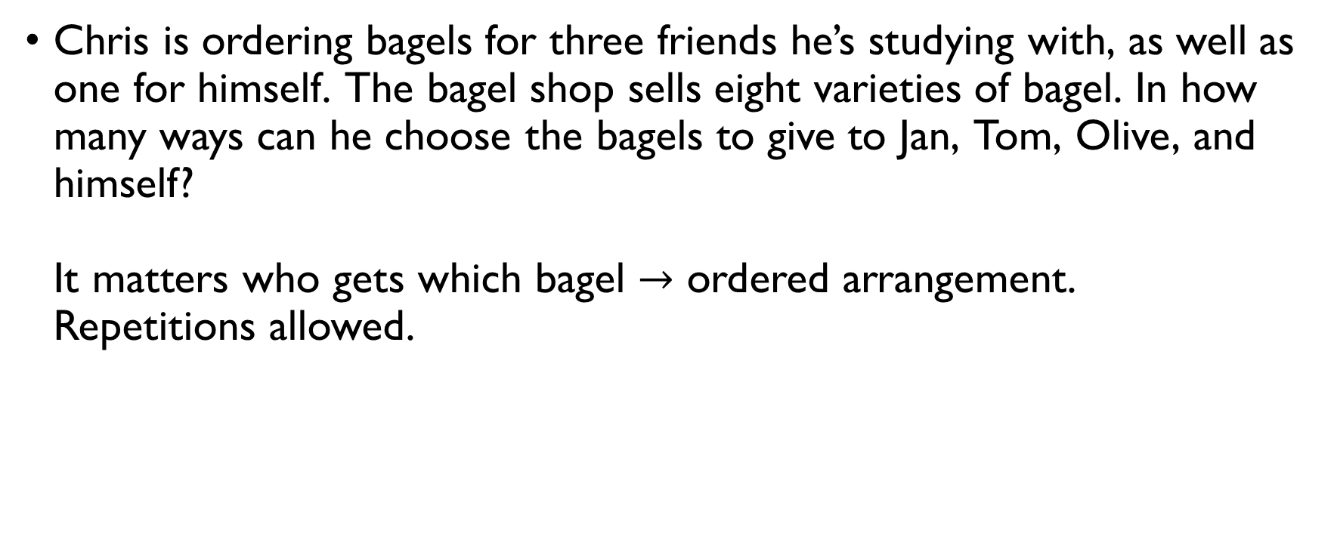
bagels
Chris is ordering bagels for three friends he’s studying with, as well as one for himself. The bagel shop sells eight varieties of bagel. In how many ways can he choose the bagels to give to Jan, Tom, Olive, and himself? It matters who gets which bagel $→$ ordered arrangement. Repetitions allowed.
$8⋅8⋅8⋅8=8^{4}$ ways to choose the bagels

Slide 14
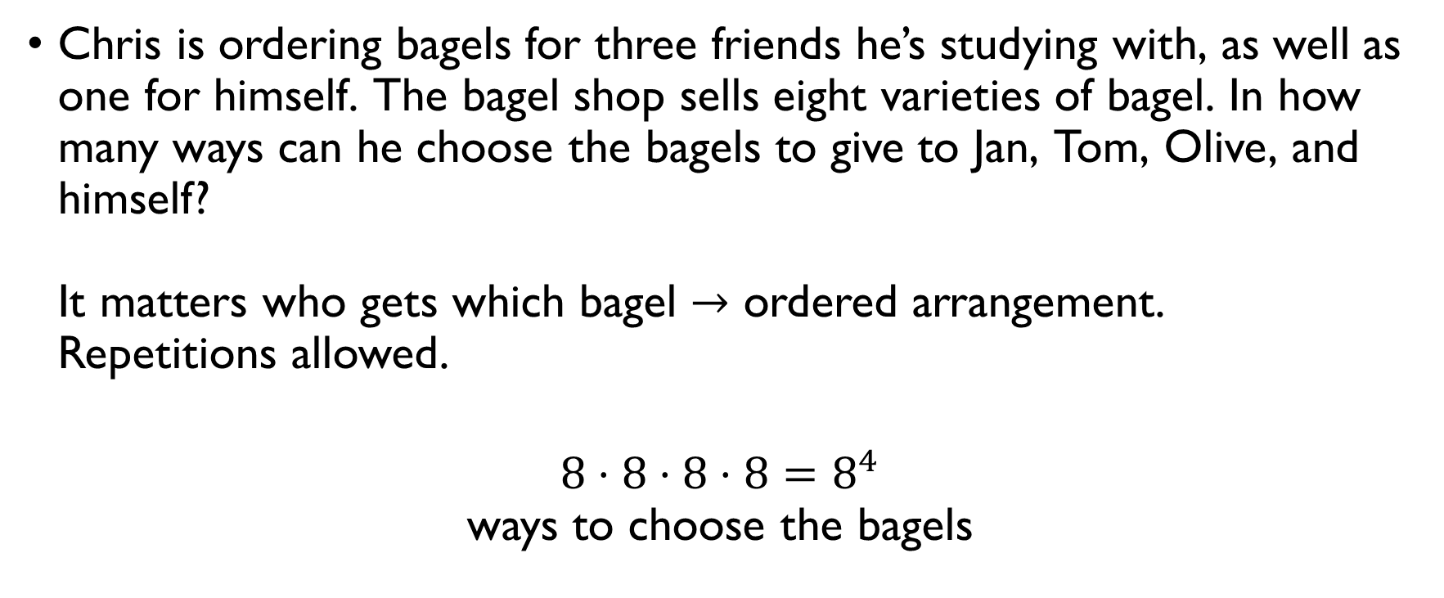
bagels
Chris is ordering bagels for three friends he’s studying with, as well as one for himself. The bagel shop sells eight varieties of bagel. In how many ways can he choose the bagels to give to Jan, Tom, Olive, and himself? It matters who gets which bagel $→$ ordered arrangement. Repetitions allowed.
$8⋅8⋅8⋅8=8^{4}$ ways to choose the bagels

Slide 15
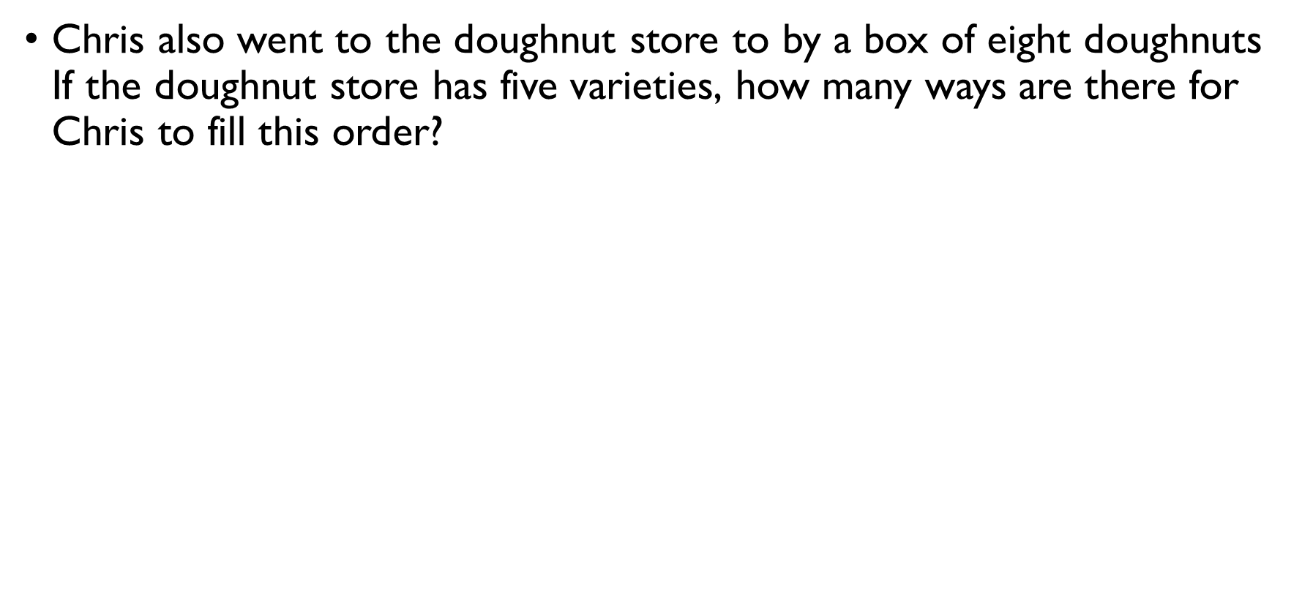
Doughnuts, part I
Chris also went to the doughnut store to by a box of eight doughnuts If the doughnut store has five varieties, how many ways are there for Chris to fill this order? Order doesn’t matter. Repetitions are allowed $→$ Combinations with repetitions
$C\left(8+5−1,5−1\right)=C\left(12,4\right)=\frac{12!}{4!8!}=495$ ways to fill a box of 8 doughnuts

Slide 16
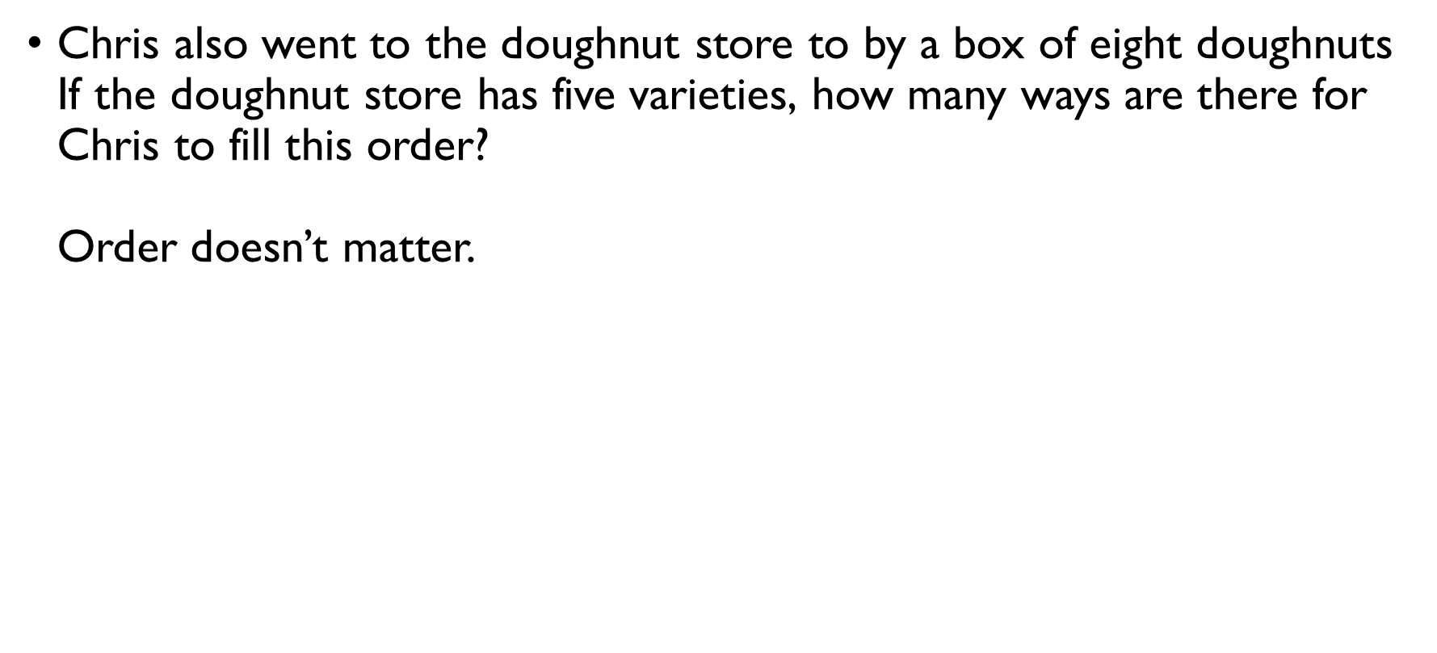
Doughnuts, part I
Chris also went to the doughnut store to by a box of eight doughnuts If the doughnut store has five varieties, how many ways are there for Chris to fill this order? Order doesn’t matter. Repetitions are allowed $→$ Combinations with repetitions
$C\left(8+5−1,5−1\right)=C\left(12,4\right)=\frac{12!}{4!8!}=495$ ways to fill a box of 8 doughnuts

Slide 17
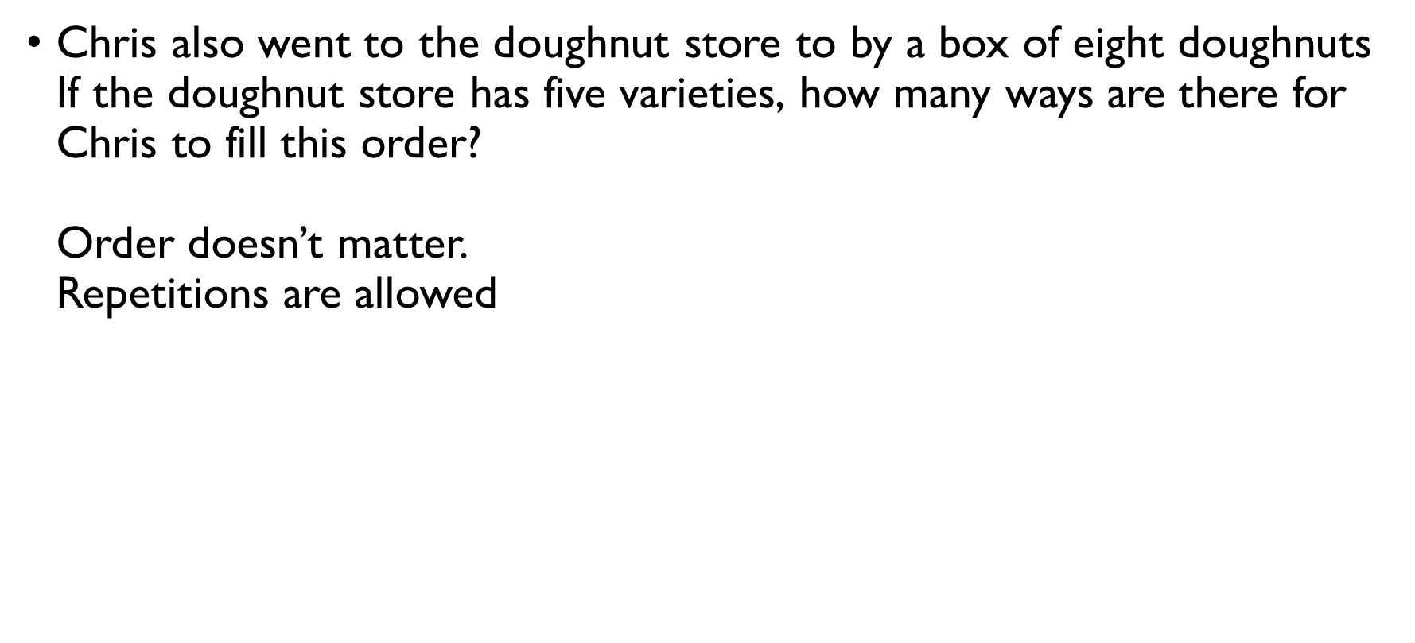
Doughnuts, part I
Chris also went to the doughnut store to by a box of eight doughnuts If the doughnut store has five varieties, how many ways are there for Chris to fill this order? Order doesn’t matter. Repetitions are allowed $→$ Combinations with repetitions
$C\left(8+5−1,5−1\right)=C\left(12,4\right)=\frac{12!}{4!8!}=495$ ways to fill a box of 8 doughnuts

Slide 18
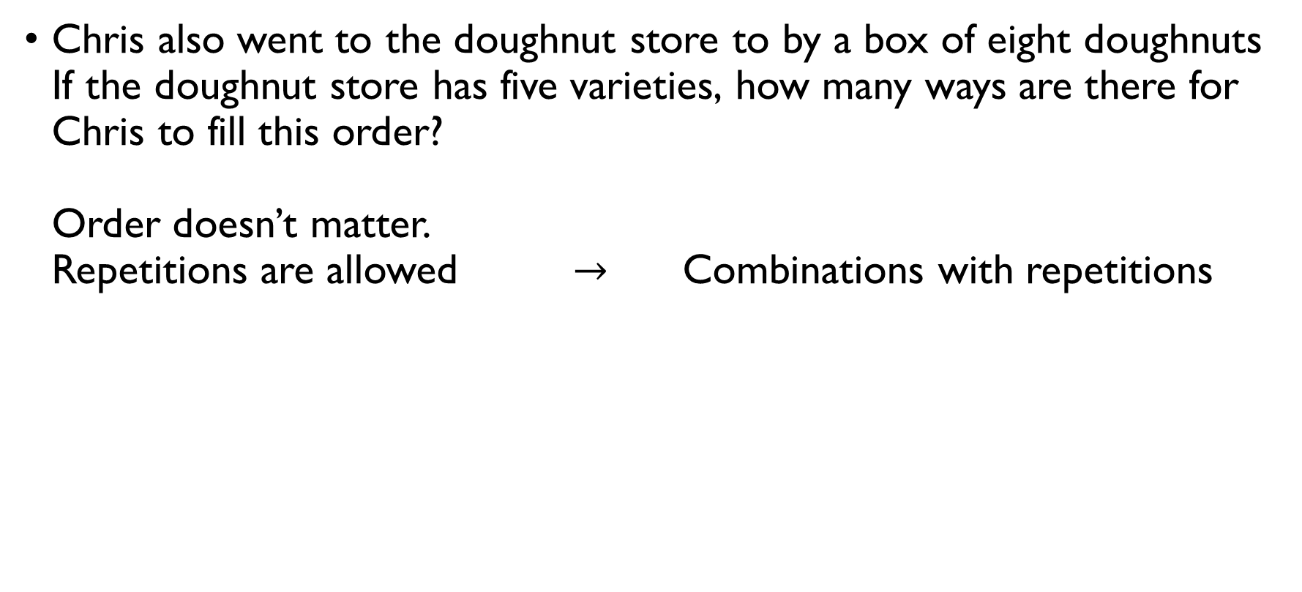
Doughnuts, part I
Chris also went to the doughnut store to by a box of eight doughnuts If the doughnut store has five varieties, how many ways are there for Chris to fill this order? Order doesn’t matter. Repetitions are allowed $→$ Combinations with repetitions
$C\left(8+5−1,5−1\right)=C\left(12,4\right)=\frac{12!}{4!8!}=495$ ways to fill a box of 8 doughnuts

Slide 19
Doughnuts, part I
Chris also went to the doughnut store to by a box of eight doughnuts If the doughnut store has five varieties, how many ways are there for Chris to fill this order? Order doesn’t matter. Repetitions are allowed $→$ Combinations with repetitions
$C\left(8+5−1,5−1\right)=C\left(12,4\right)=\frac{12!}{4!8!}=495$ ways to fill a box of 8 doughnuts

Slide 20
Doughnuts, part I
Chris also went to the doughnut store to by a box of eight doughnuts If the doughnut store has five varieties, how many ways are there for Chris to fill this order? Order doesn’t matter. Repetitions are allowed $→$ Combinations with repetitions
$C\left(8+5−1,5−1\right)=C\left(12,4\right)=\frac{12!}{4!8!}=495$ ways to fill a box of 8 doughnuts

Slide 21
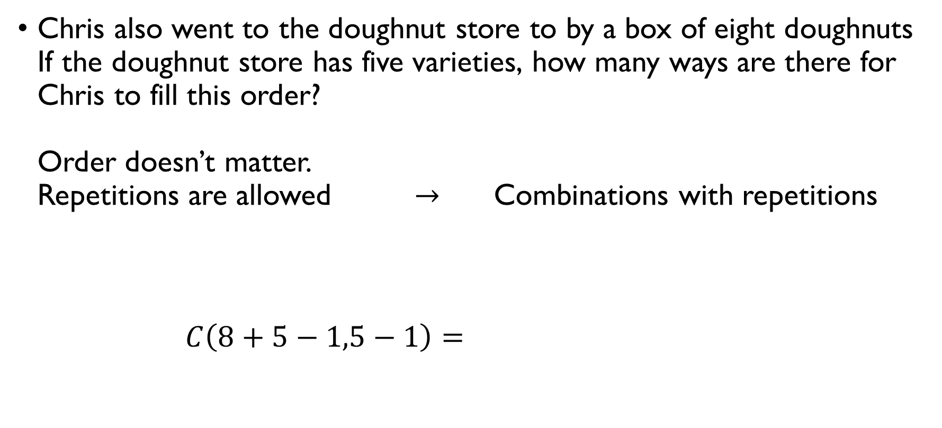
Doughnuts, part I
Chris also went to the doughnut store to by a box of eight doughnuts If the doughnut store has five varieties, how many ways are there for Chris to fill this order? Order doesn’t matter. Repetitions are allowed $→$ Combinations with repetitions
$C\left(8+5−1,5−1\right)=C\left(12,4\right)=\frac{12!}{4!8!}=495$ ways to fill a box of 8 doughnuts

Slide 22
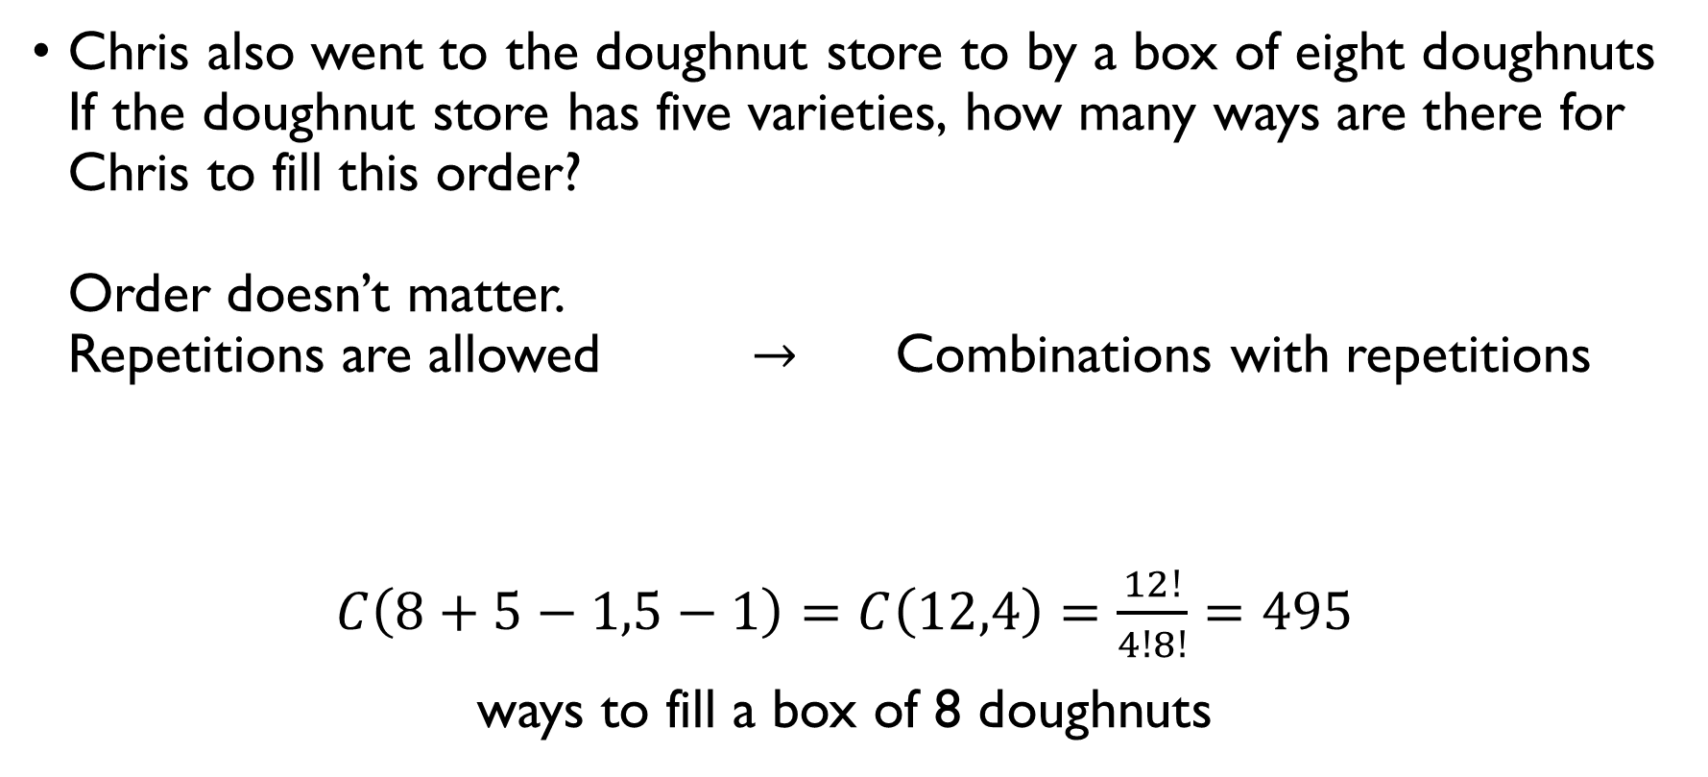
Doughnuts, part I
Chris also went to the doughnut store to by a box of eight doughnuts If the doughnut store has five varieties, how many ways are there for Chris to fill this order? Order doesn’t matter. Repetitions are allowed $→$ Combinations with repetitions
$C\left(8+5−1,5−1\right)=C\left(12,4\right)=\frac{12!}{4!8!}=495$ ways to fill a box of 8 doughnuts

Slide 23
Doughnuts, part 1
This corresponds to the number of non-negative integer solutions of which equation?
Chris also went to the doughnut store to by a box of eight doughnuts If the doughnut store has five varieties, how many ways are there for Chris to fill this order? Order doesn’t matter. Repetitions are allowed $→$ Combinations with repetitions
$C\left(8+5−1,5−1\right)=C\left(12,4\right)=\frac{12!}{4!8!}=495$ ways to fill a box of 8 doughnuts
$x_{1}+x_{2}+x_{3}+x_{4}=12$
$x_{1}+x_{2}+x_{3}+x_{4}+x_{5}=8$
$x_{1}+x_{2}+…+x_{11}+x_{12}=4$
$x_{1}+x_{2}+…+x_{7}+x_{8}=5$

Slide 24
Doughnuts, part 1
This corresponds to the number of non-negative integer solutions of which equation?
Chris also went to the doughnut store to by a box of eight doughnuts If the doughnut store has five varieties, how many ways are there for Chris to fill this order? Order doesn’t matter. Repetitions are allowed $→$ Combinations with repetitions
$C\left(8+5−1,5−1\right)=C\left(12,4\right)=\frac{12!}{4!8!}=495$ ways to fill a box of 8 doughnuts
$x_{1}+x_{2}+x_{3}+x_{4}=12$
$x_{1}+x_{2}+x_{3}+x_{4}+x_{5}=8$
$x_{1}+x_{2}+…+x_{11}+x_{12}=4$
$x_{1}+x_{2}+…+x_{7}+x_{8}=5$

Slide 25
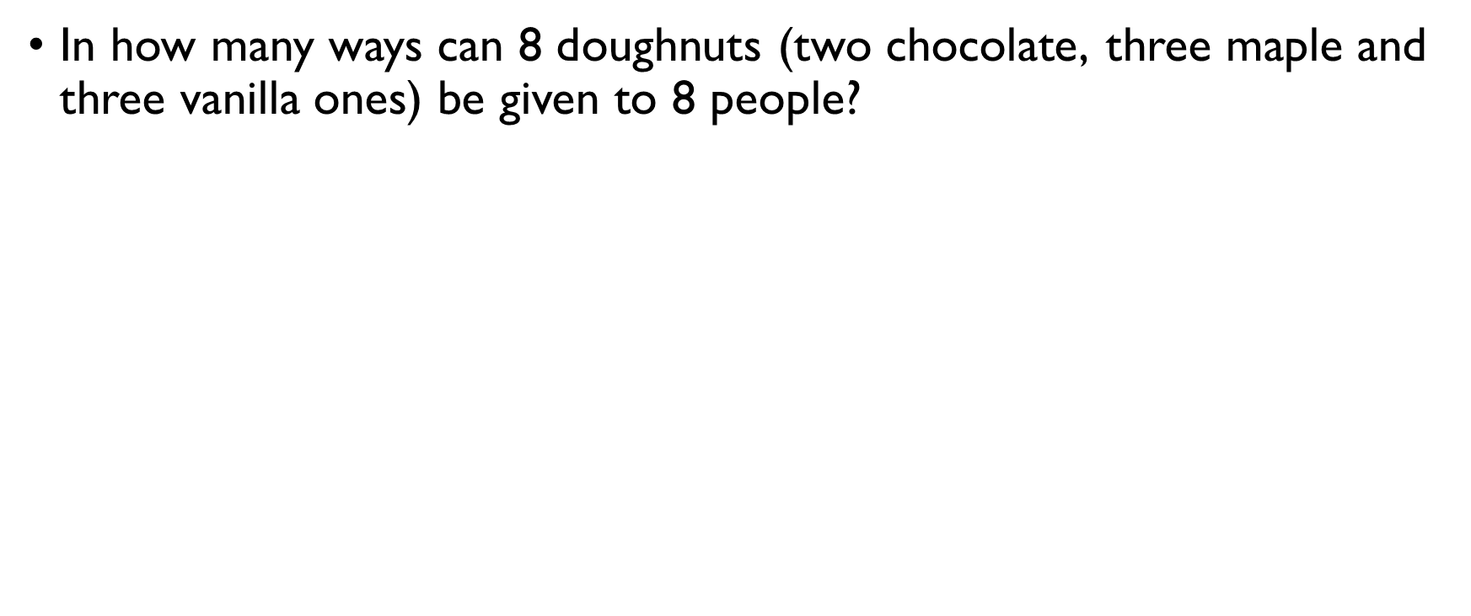
Doughnuts, part II
In how many ways can 8 doughnuts (two chocolate, three maple and three vanilla ones) be given to 8 people? Doughnuts are assigned to different people ordered arrangement Some objects are repeated
$$\frac{8!}{2!⋅3!⋅3!}$$ unique ways to “order” repeating doughnuts

Slide 26
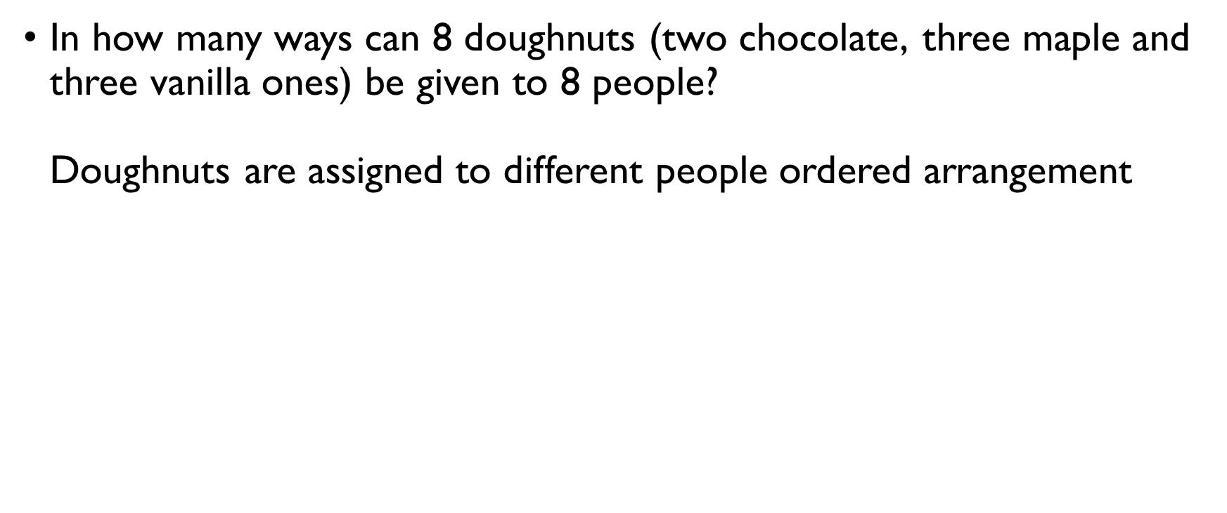
Doughnuts, part II
In how many ways can 8 doughnuts (two chocolate, three maple and three vanilla ones) be given to 8 people? Doughnuts are assigned to different people ordered arrangement Some objects are repeated
$$\frac{8!}{2!⋅3!⋅3!}$$ unique ways to “order” repeating doughnuts

Slide 27
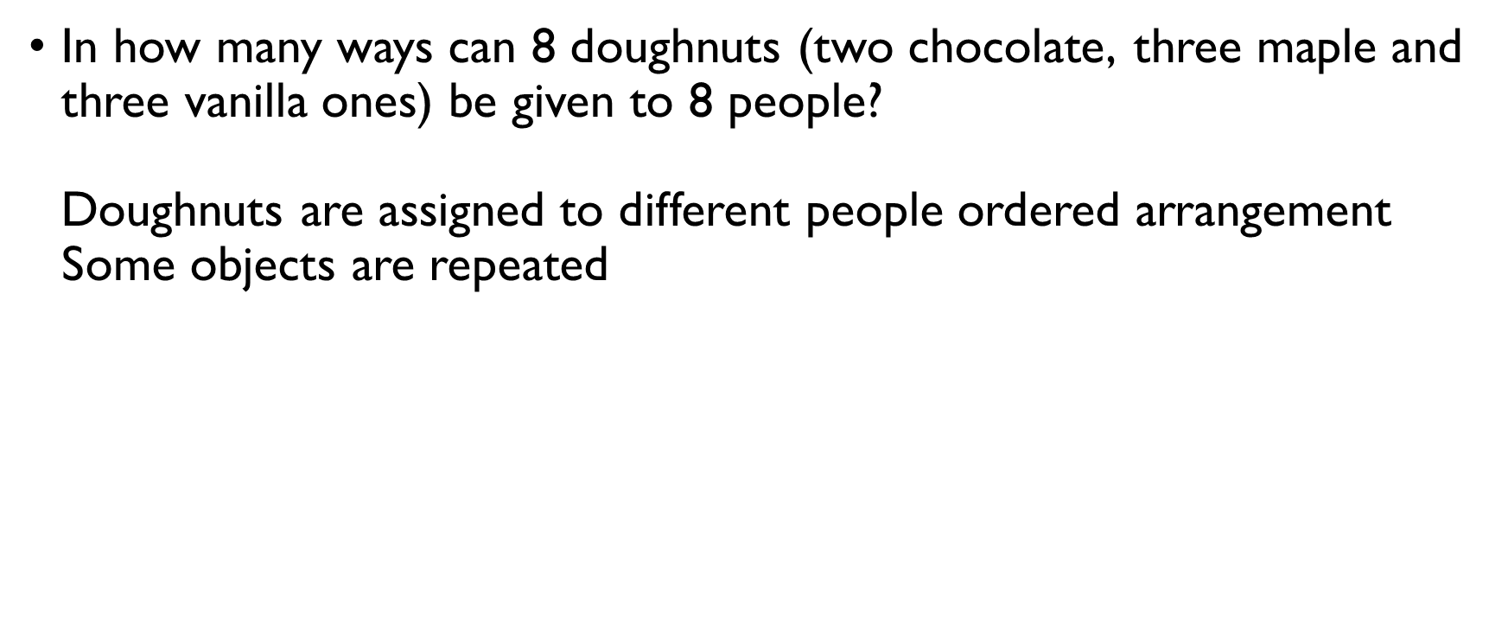
Doughnuts, part II
In how many ways can 8 doughnuts (two chocolate, three maple and three vanilla ones) be given to 8 people? Doughnuts are assigned to different people ordered arrangement Some objects are repeated
$$\frac{8!}{2!⋅3!⋅3!}$$ unique ways to “order” repeating doughnuts

Slide 28
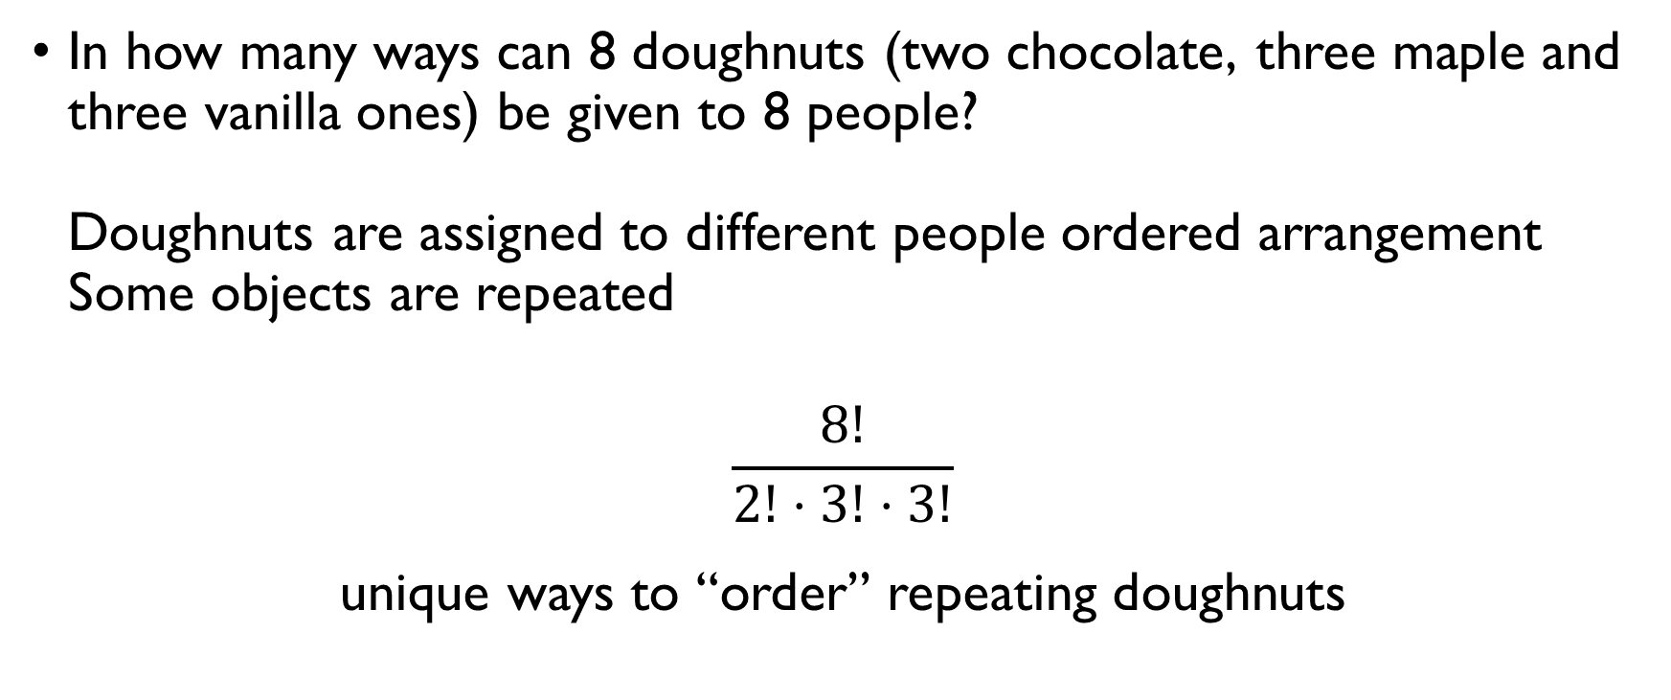
Doughnuts, part II
In how many ways can 8 doughnuts (two chocolate, three maple and three vanilla ones) be given to 8 people? Doughnuts are assigned to different people ordered arrangement Some objects are repeated
$$\frac{8!}{2!⋅3!⋅3!}$$ unique ways to “order” repeating doughnuts

Slide 29
PROBLEM SET 4
Permutations and combinations

Slide 30
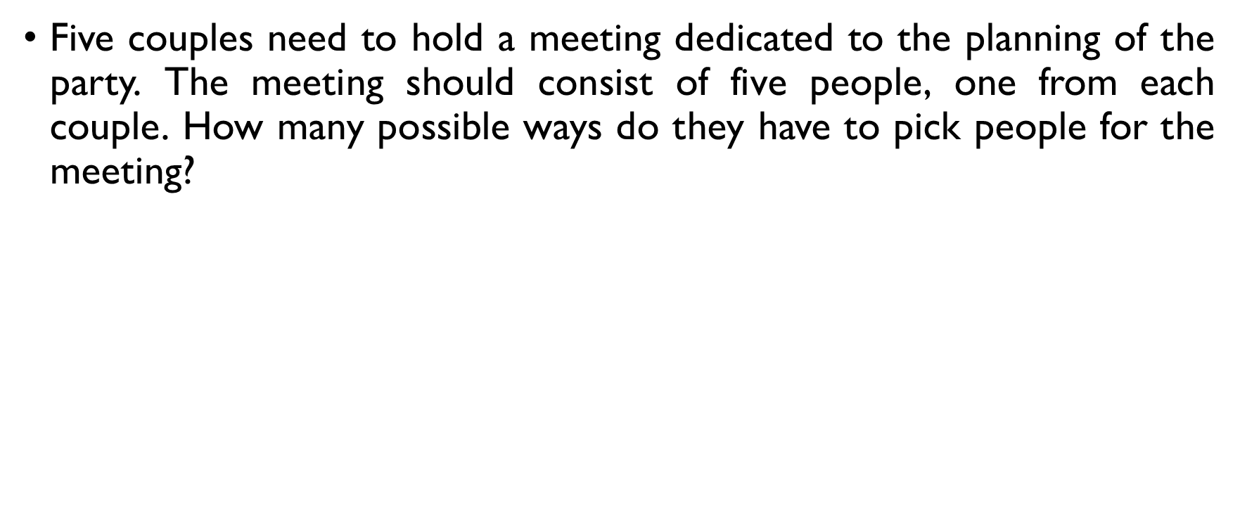
A party – part 1
Five couples need to hold a meeting dedicated to the planning of the party. The meeting should consist of five people, one from each couple. How many possible ways do they have to pick people for the meeting?
We need a representative from every couple:
$$2⋅2⋅2⋅2⋅2=2^{5}$$

Slide 31
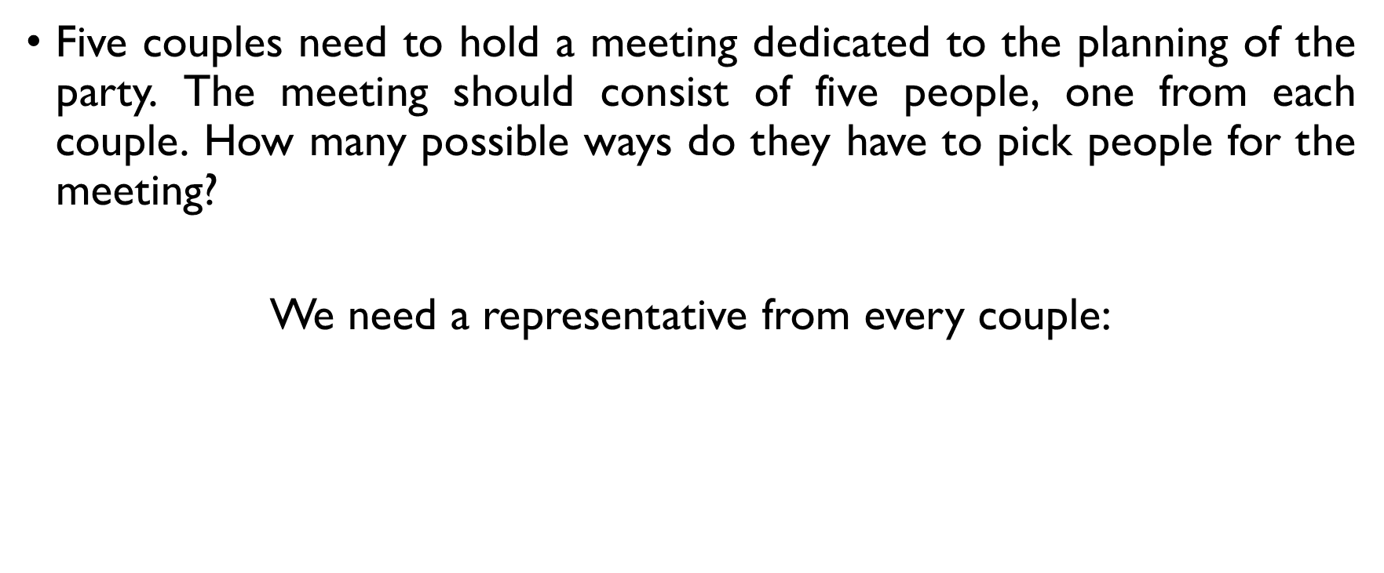
A party – part 1
Five couples need to hold a meeting dedicated to the planning of the party. The meeting should consist of five people, one from each couple. How many possible ways do they have to pick people for the meeting?
We need a representative from every couple:
$$2⋅2⋅2⋅2⋅2=2^{5}$$

Slide 32
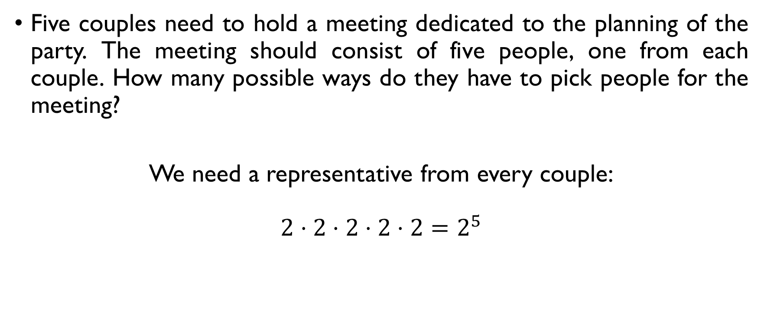
A party – part 1
Five couples need to hold a meeting dedicated to the planning of the party. The meeting should consist of five people, one from each couple. How many possible ways do they have to pick people for the meeting?
We need a representative from every couple:
$$2⋅2⋅2⋅2⋅2=2^{5}$$

Slide 33
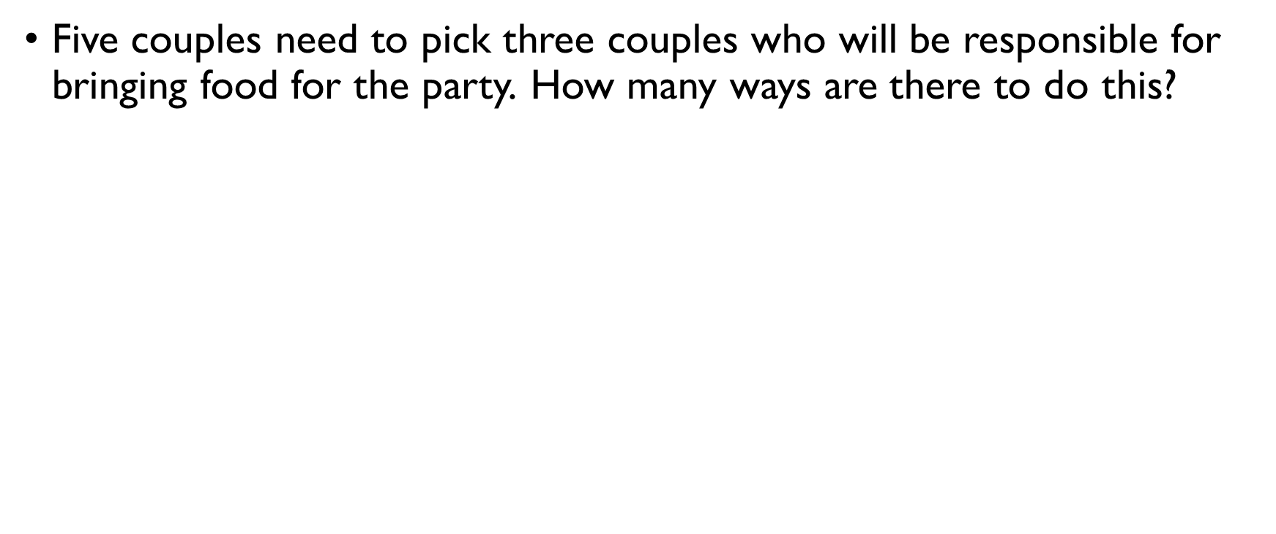
A party – part 2
Five couples need to pick three couples who will be responsible for bringing food for the party. How many ways are there to do this?
Order doesn’t matter
$$C\left(5,3\right)=\frac{5!}{3!2!}=10$$

Slide 34
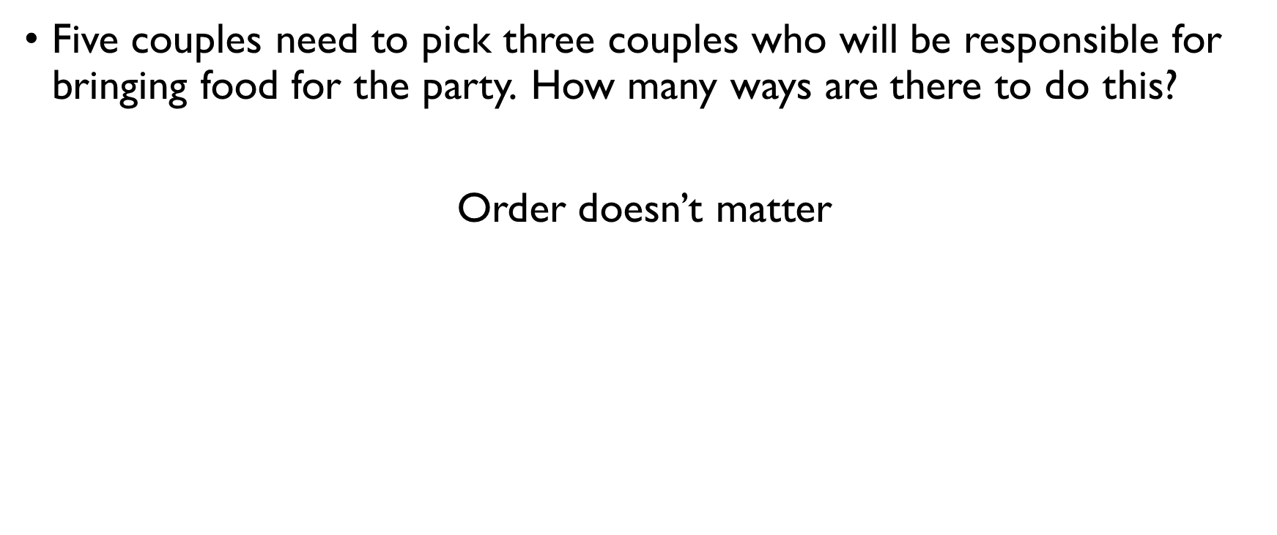
A party – part 2
Five couples need to pick three couples who will be responsible for bringing food for the party. How many ways are there to do this?
Order doesn’t matter
$$C\left(5,3\right)=\frac{5!}{3!2!}=10$$

Slide 35
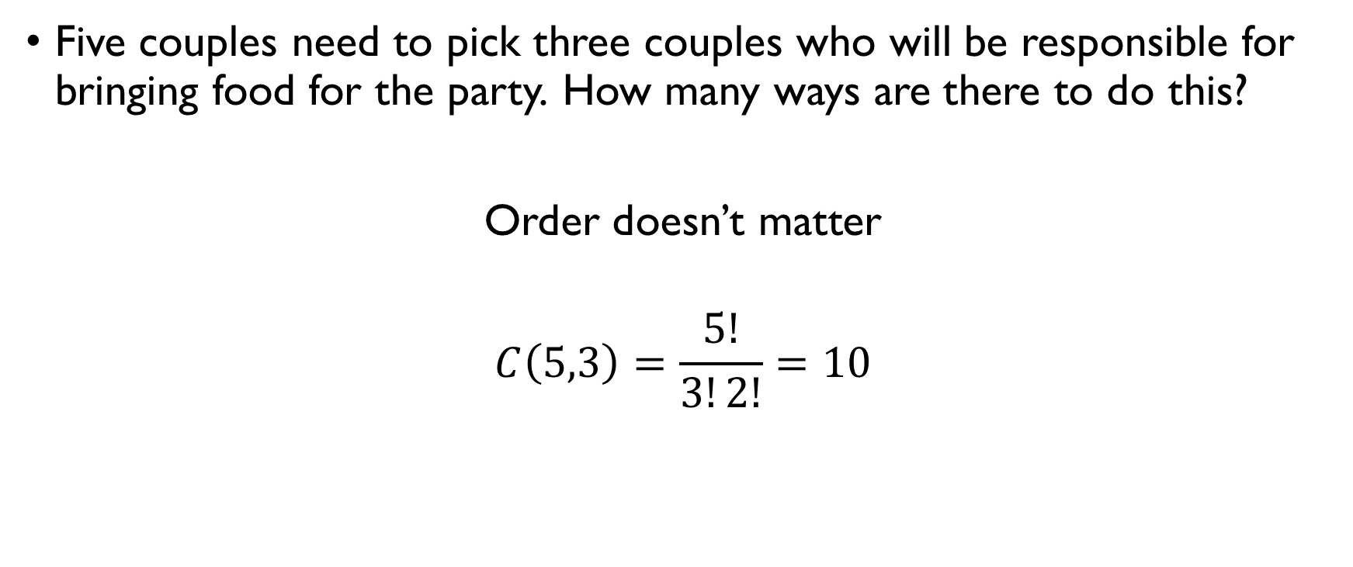
A party – part 2
Five couples need to pick three couples who will be responsible for bringing food for the party. How many ways are there to do this?
Order doesn’t matter
$$C\left(5,3\right)=\frac{5!}{3!2!}=10$$

Slide 36
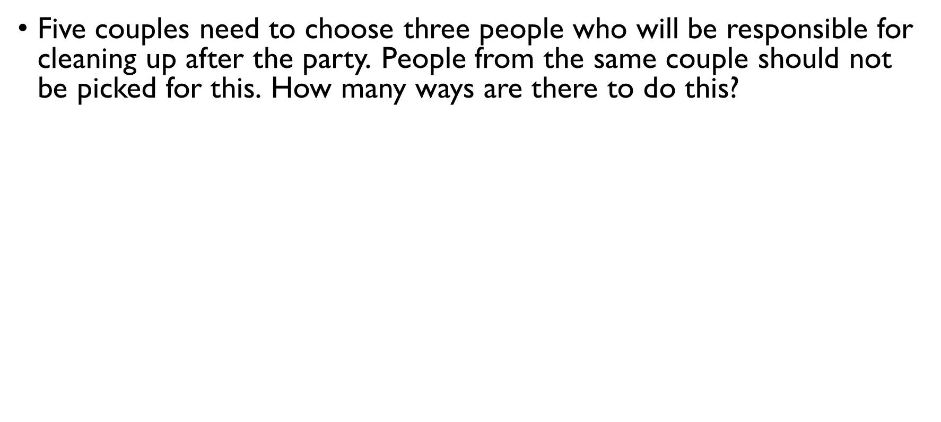
A party – part 3
Five couples need to choose three people who will be responsible for cleaning up after the party. People from the same couple should not be picked for this. How many ways are there to do this?
Let’s first chose three couples: $C\left(5,3\right)$
Now, let’s chose one of the two people in each couple: $2⋅2⋅2$
Putting it all together:
$$C\left(5,3\right)⋅2⋅2⋅2=80$$

Slide 37
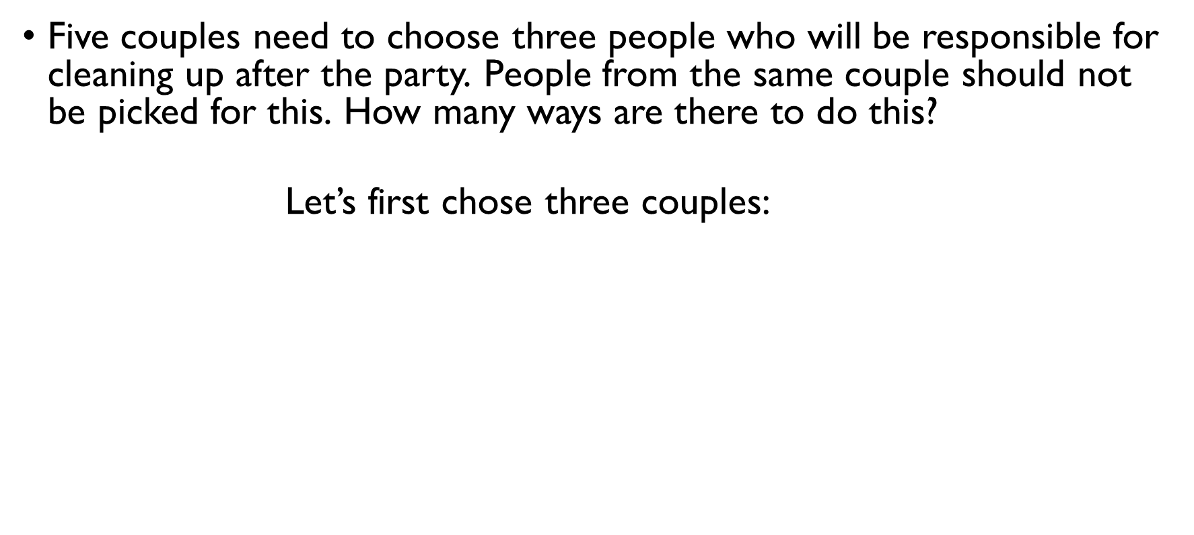
A party – part 3
Five couples need to choose three people who will be responsible for cleaning up after the party. People from the same couple should not be picked for this. How many ways are there to do this?
Let’s first chose three couples: $C\left(5,3\right)$
Now, let’s chose one of the two people in each couple: $2⋅2⋅2$
Putting it all together:
$$C\left(5,3\right)⋅2⋅2⋅2=80$$

Slide 38
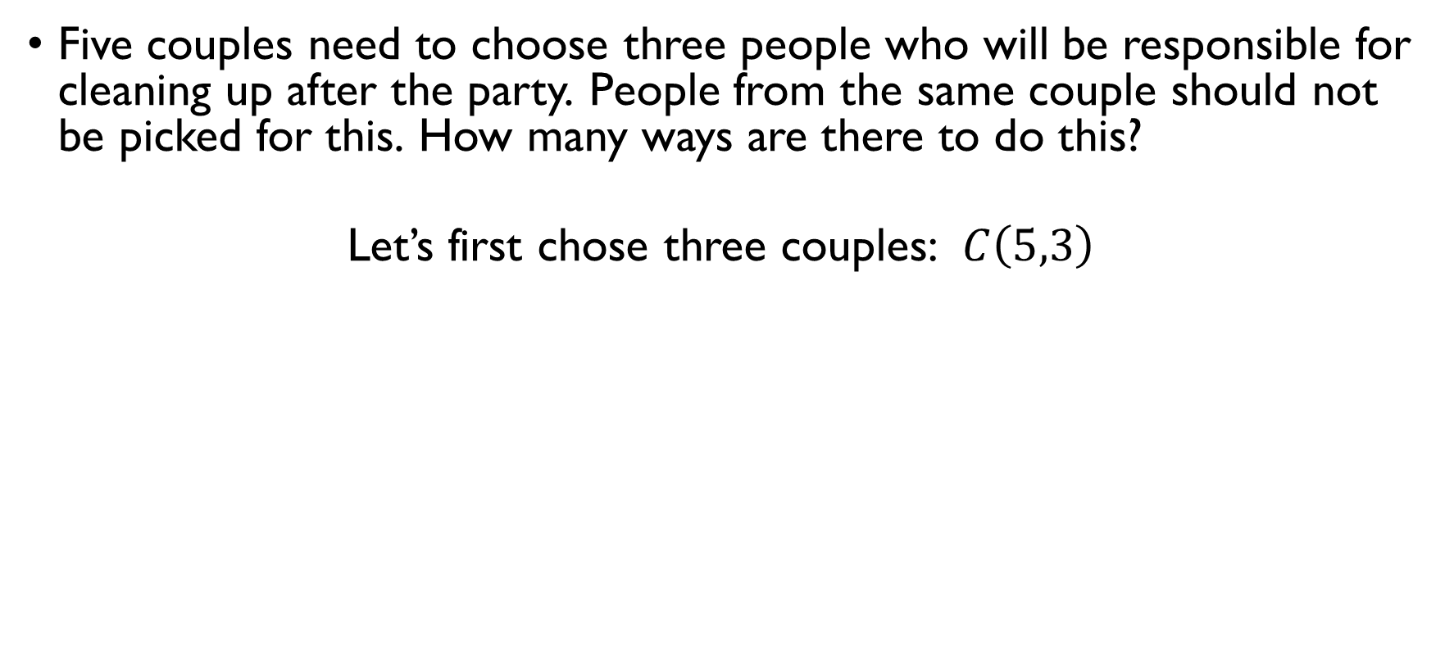
A party – part 3
Five couples need to choose three people who will be responsible for cleaning up after the party. People from the same couple should not be picked for this. How many ways are there to do this?
Let’s first chose three couples: $C\left(5,3\right)$
Now, let’s chose one of the two people in each couple: $2⋅2⋅2$
Putting it all together:
$$C\left(5,3\right)⋅2⋅2⋅2=80$$

Slide 39
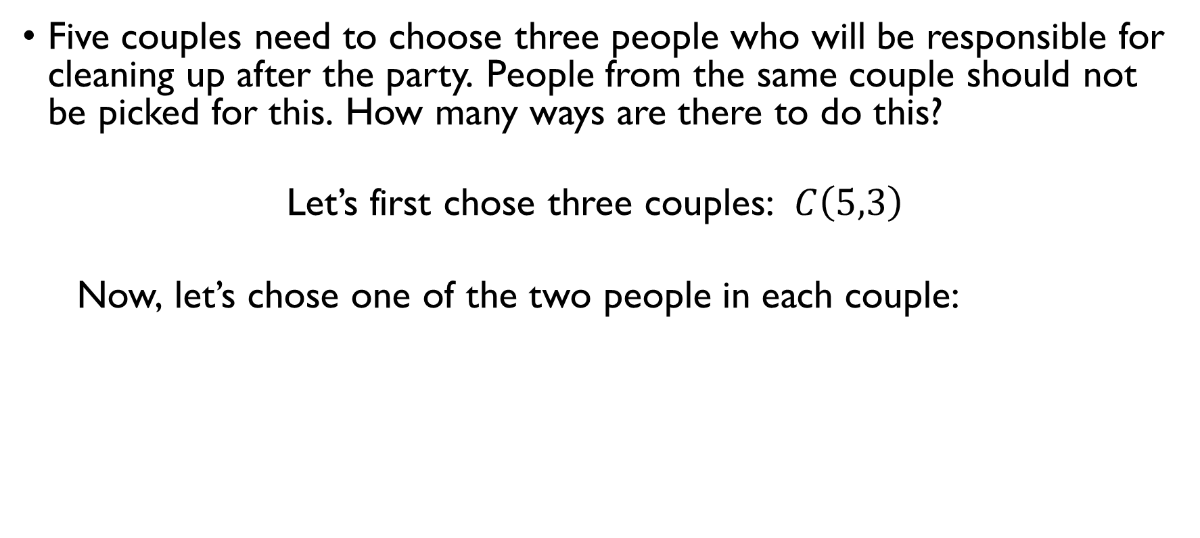
A party – part 3
Five couples need to choose three people who will be responsible for cleaning up after the party. People from the same couple should not be picked for this. How many ways are there to do this?
Let’s first chose three couples: $C\left(5,3\right)$
Now, let’s chose one of the two people in each couple: $2⋅2⋅2$
Putting it all together:
$$C\left(5,3\right)⋅2⋅2⋅2=80$$

Slide 40
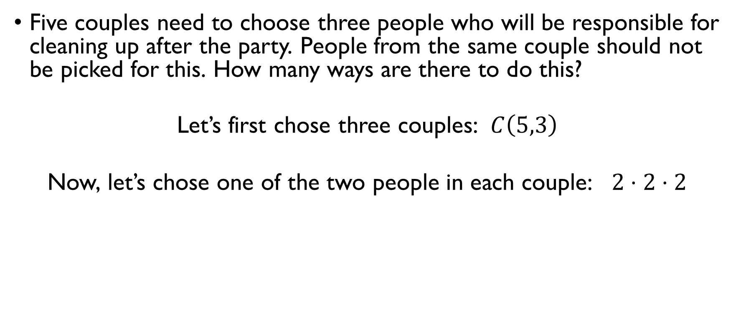
A party – part 3
Five couples need to choose three people who will be responsible for cleaning up after the party. People from the same couple should not be picked for this. How many ways are there to do this?
Let’s first chose three couples: $C\left(5,3\right)$
Now, let’s chose one of the two people in each couple: $2⋅2⋅2$
Putting it all together:
$$C\left(5,3\right)⋅2⋅2⋅2=80$$

Slide 41
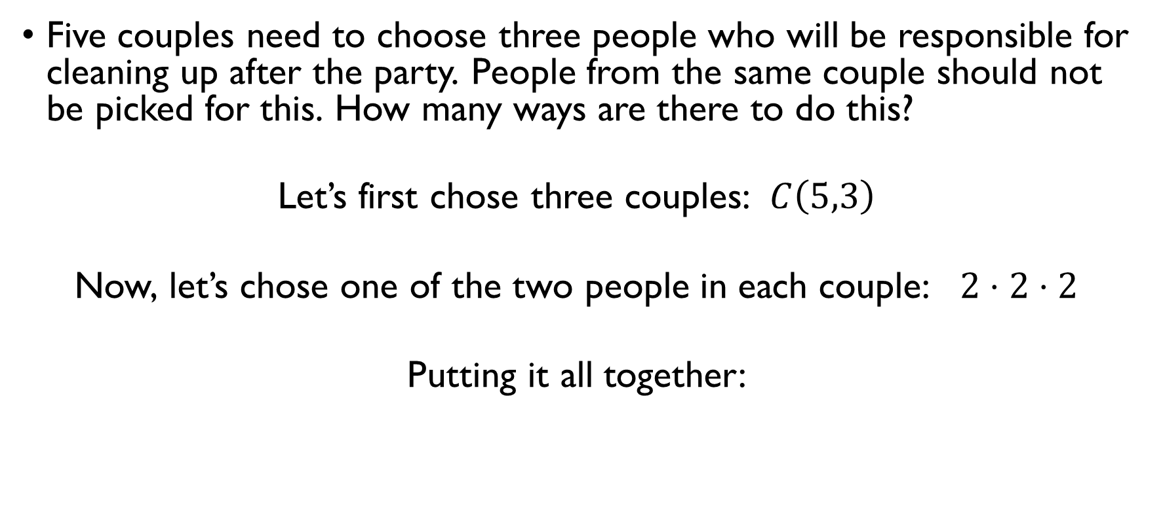
A party – part 3
Five couples need to choose three people who will be responsible for cleaning up after the party. People from the same couple should not be picked for this. How many ways are there to do this?
Let’s first chose three couples: $C\left(5,3\right)$
Now, let’s chose one of the two people in each couple: $2⋅2⋅2$
Putting it all together:
$$C\left(5,3\right)⋅2⋅2⋅2=80$$

Slide 42
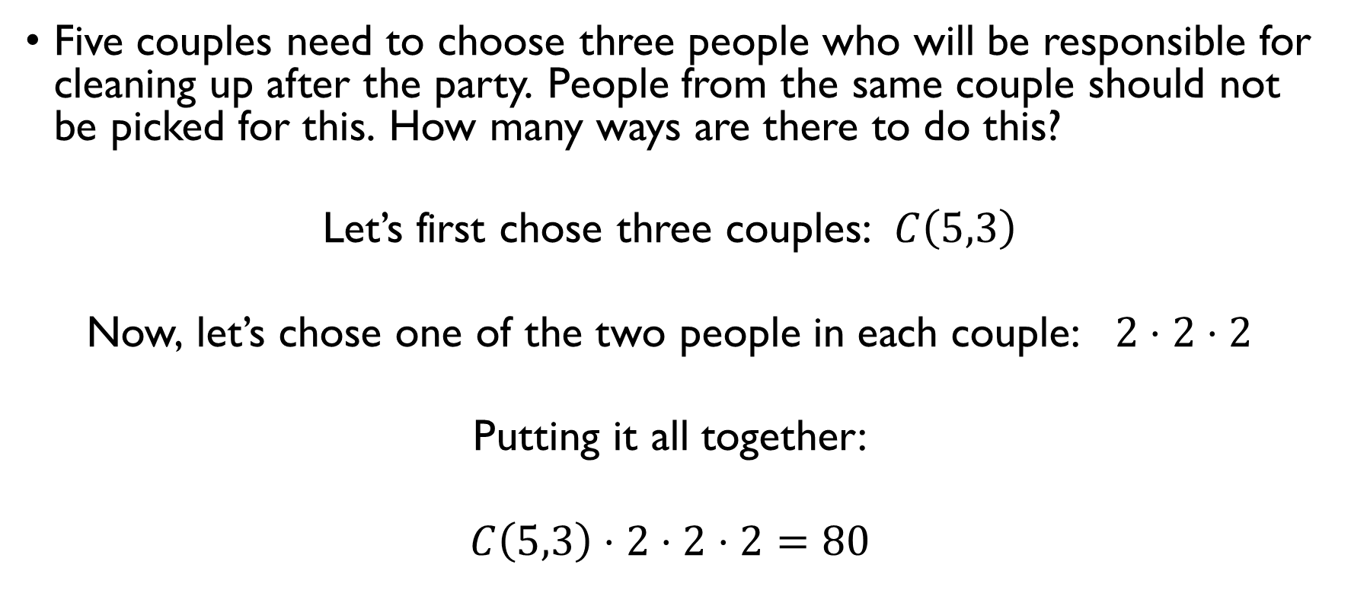
A party – part 3
Five couples need to choose three people who will be responsible for cleaning up after the party. People from the same couple should not be picked for this. How many ways are there to do this?
Let’s first chose three couples: $C\left(5,3\right)$
Now, let’s chose one of the two people in each couple: $2⋅2⋅2$
Putting it all together:
$$C\left(5,3\right)⋅2⋅2⋅2=80$$

Slide 43
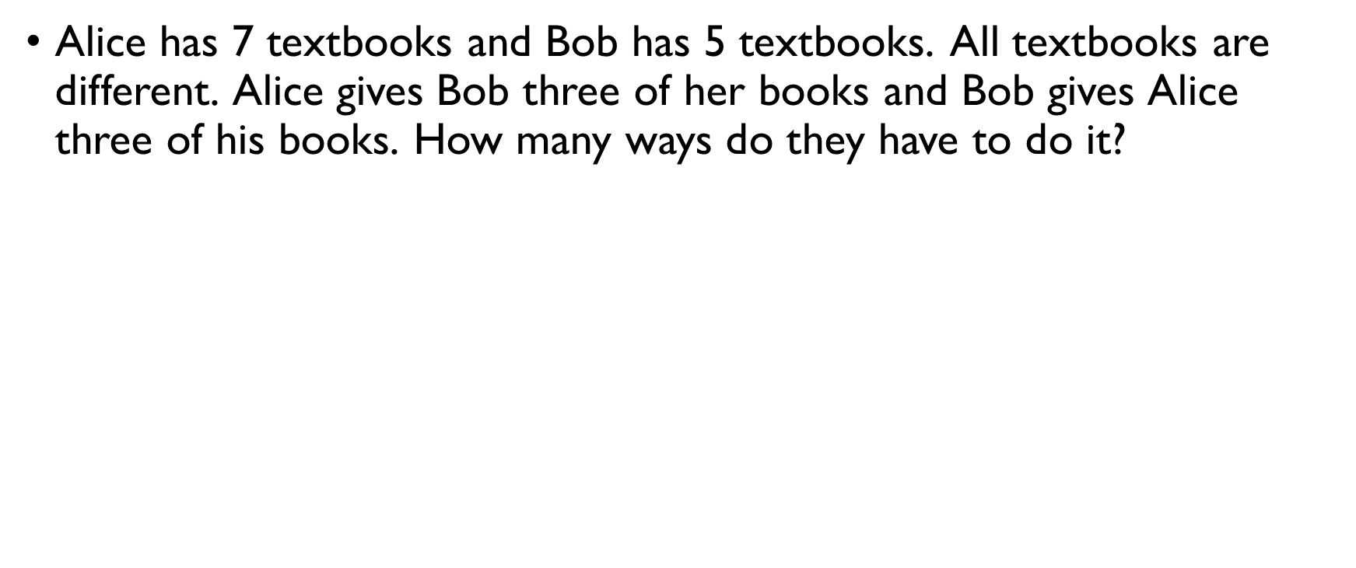
Book club
Alice has 7 textbooks and Bob has 5 textbooks. All textbooks are different. Alice gives Bob three of her books and Bob gives Alice three of his books. How many ways do they have to do it? Order doesn’t matter $→$ counting combinations. + Product rule:
$$C\left(7,3\right)⋅C\left(5,3\right)=\frac{7!}{3!4!}⋅\frac{5!}{3!2!}$$

Slide 44
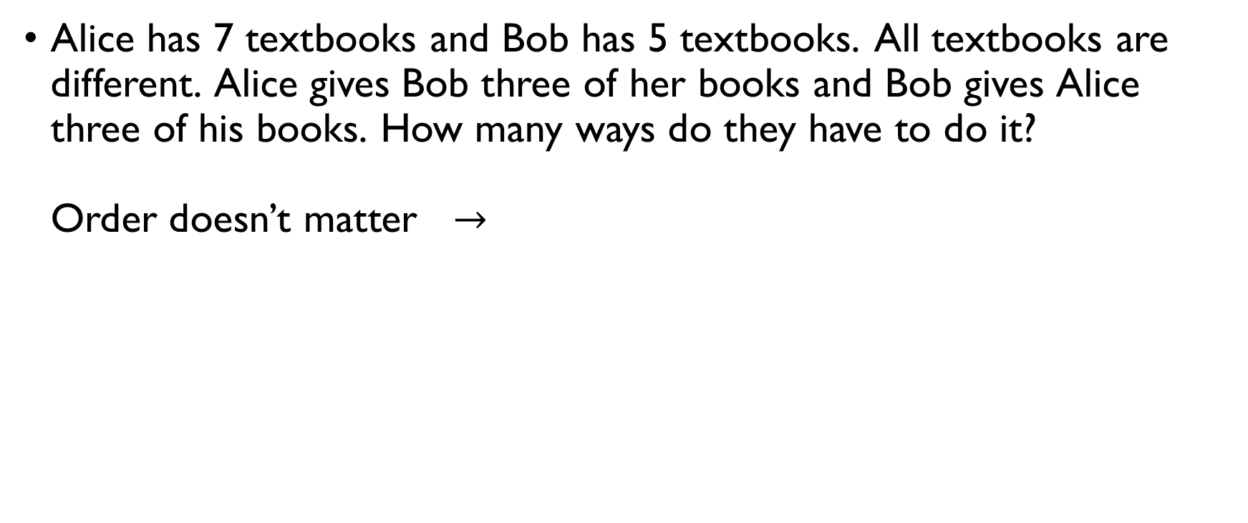
Book club
Alice has 7 textbooks and Bob has 5 textbooks. All textbooks are different. Alice gives Bob three of her books and Bob gives Alice three of his books. How many ways do they have to do it? Order doesn’t matter $→$ counting combinations. + Product rule:
$$C\left(7,3\right)⋅C\left(5,3\right)=\frac{7!}{3!4!}⋅\frac{5!}{3!2!}$$

Slide 45
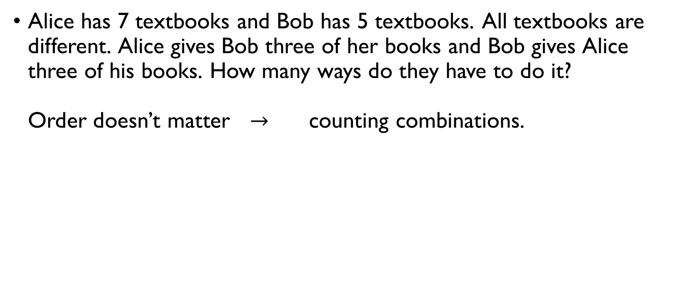
Book club
Alice has 7 textbooks and Bob has 5 textbooks. All textbooks are different. Alice gives Bob three of her books and Bob gives Alice three of his books. How many ways do they have to do it? Order doesn’t matter $→$ counting combinations. + Product rule:
$$C\left(7,3\right)⋅C\left(5,3\right)=\frac{7!}{3!4!}⋅\frac{5!}{3!2!}$$

Slide 46
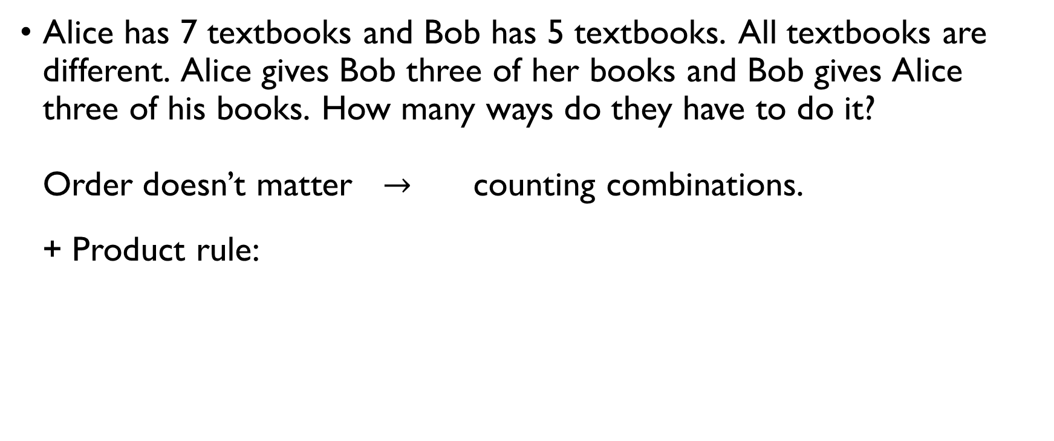
Book club
Alice has 7 textbooks and Bob has 5 textbooks. All textbooks are different. Alice gives Bob three of her books and Bob gives Alice three of his books. How many ways do they have to do it? Order doesn’t matter $→$ counting combinations. + Product rule:
$$C\left(7,3\right)⋅C\left(5,3\right)=\frac{7!}{3!4!}⋅\frac{5!}{3!2!}$$

Slide 47
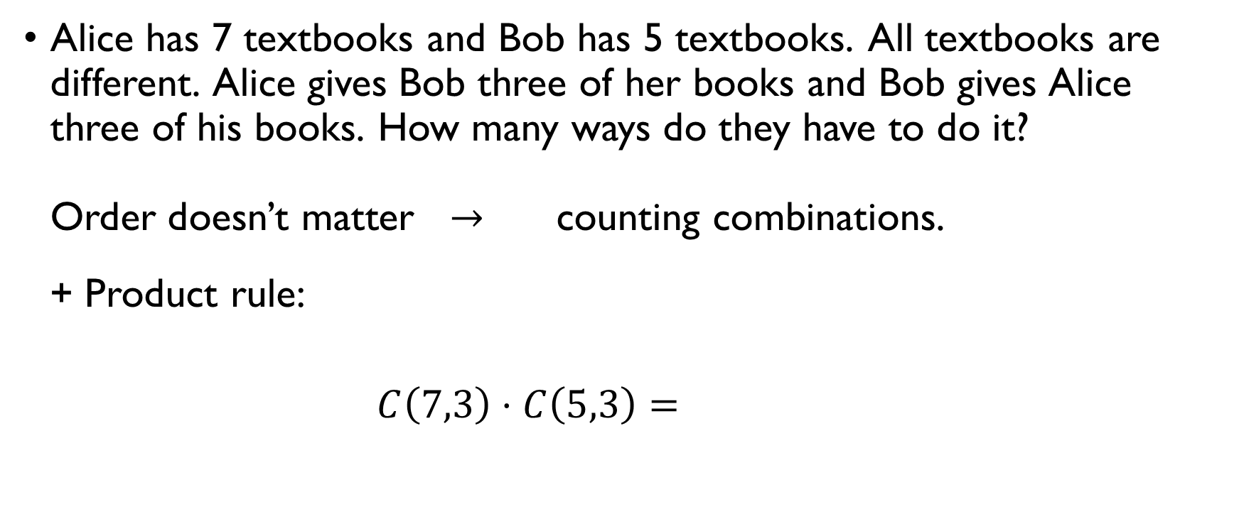
Book club
Alice has 7 textbooks and Bob has 5 textbooks. All textbooks are different. Alice gives Bob three of her books and Bob gives Alice three of his books. How many ways do they have to do it? Order doesn’t matter $→$ counting combinations. + Product rule:
$$C\left(7,3\right)⋅C\left(5,3\right)=\frac{7!}{3!4!}⋅\frac{5!}{3!2!}$$

Slide 48
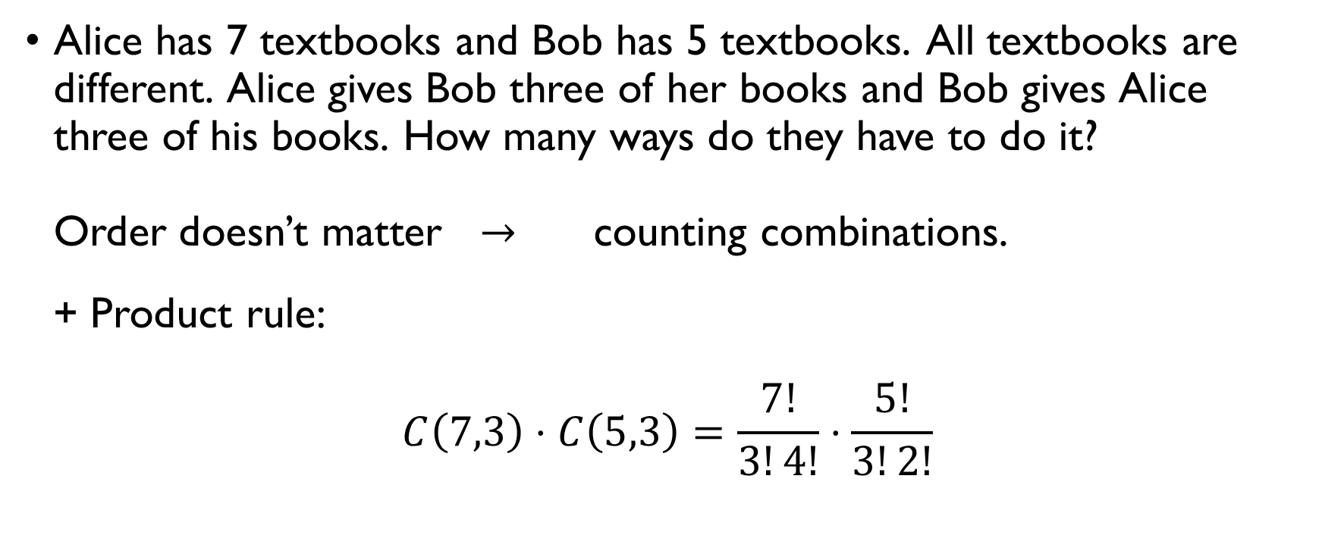
Book club
Alice has 7 textbooks and Bob has 5 textbooks. All textbooks are different. Alice gives Bob three of her books and Bob gives Alice three of his books. How many ways do they have to do it? Order doesn’t matter $→$ counting combinations. + Product rule:
$$C\left(7,3\right)⋅C\left(5,3\right)=\frac{7!}{3!4!}⋅\frac{5!}{3!2!}$$

Slide 49
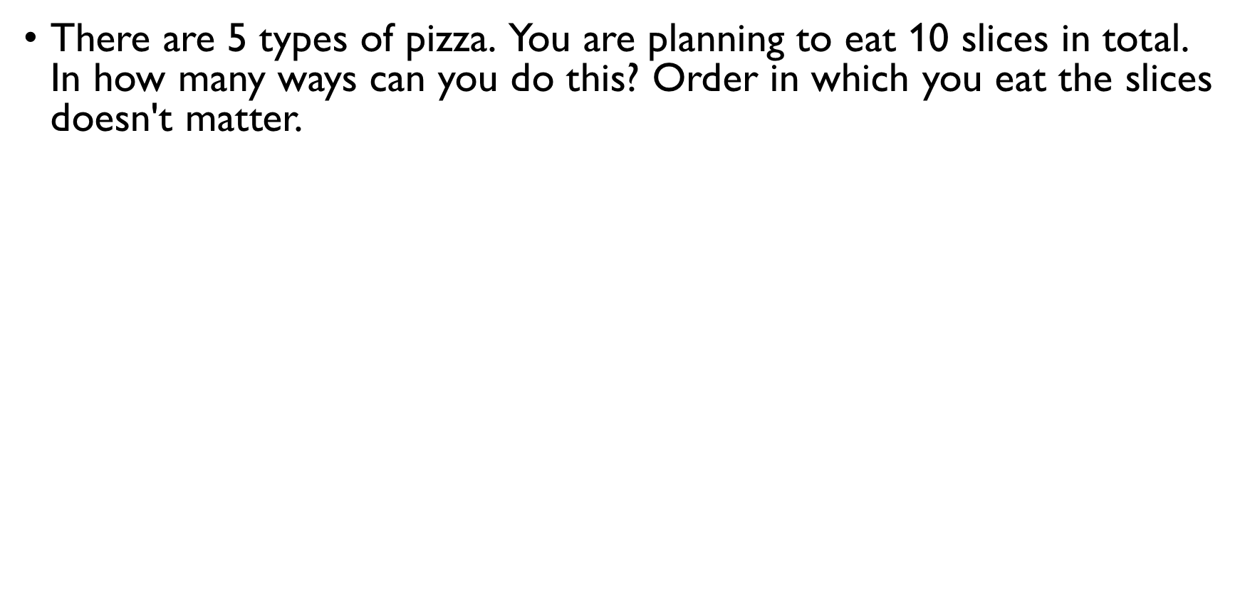
PIZZA
There are 5 types of pizza. You are planning to eat 10 slices in total. In how many ways can you do this? Order in which you eat the slices doesn't matter. Order doesn’t matter $→$ counting combinations Repetitions are allowed with repetitions
slices = “balls” types of pizza = “colour”, category
$C\left(10+5−1,5−1\right)=C\left(14,4\right)=\frac{14!}{10!4!}=\frac{14⋅13⋅12⋅11}{4!}=1001$ ways of eating 10 slices of pizza of 5 types

Slide 50
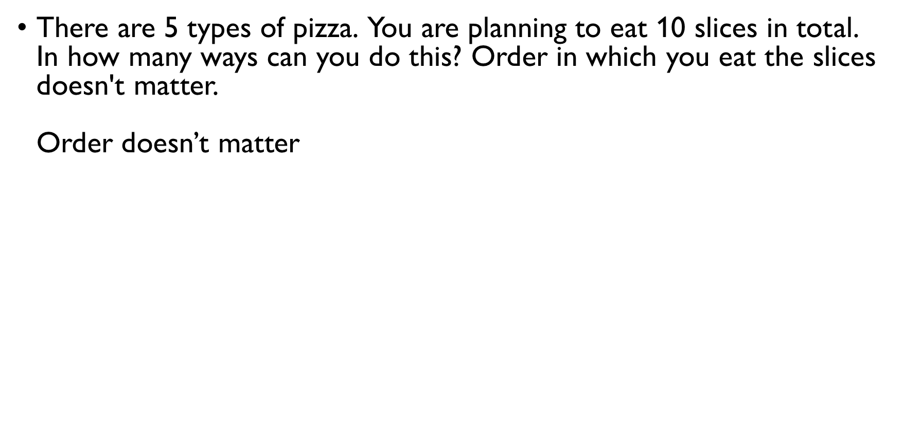
PIZZA
There are 5 types of pizza. You are planning to eat 10 slices in total. In how many ways can you do this? Order in which you eat the slices doesn't matter. Order doesn’t matter $→$ counting combinations Repetitions are allowed with repetitions
slices = “balls” types of pizza = “colour”, category
$C\left(10+5−1,5−1\right)=C\left(14,4\right)=\frac{14!}{10!4!}=\frac{14⋅13⋅12⋅11}{4!}=1001$ ways of eating 10 slices of pizza of 5 types

Slide 51
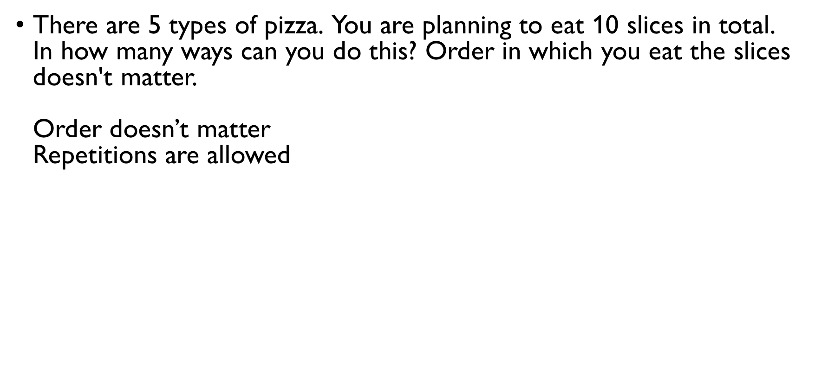
PIZZA
There are 5 types of pizza. You are planning to eat 10 slices in total. In how many ways can you do this? Order in which you eat the slices doesn't matter. Order doesn’t matter $→$ counting combinations Repetitions are allowed with repetitions
slices = “balls” types of pizza = “colour”, category
$C\left(10+5−1,5−1\right)=C\left(14,4\right)=\frac{14!}{10!4!}=\frac{14⋅13⋅12⋅11}{4!}=1001$ ways of eating 10 slices of pizza of 5 types

Slide 52
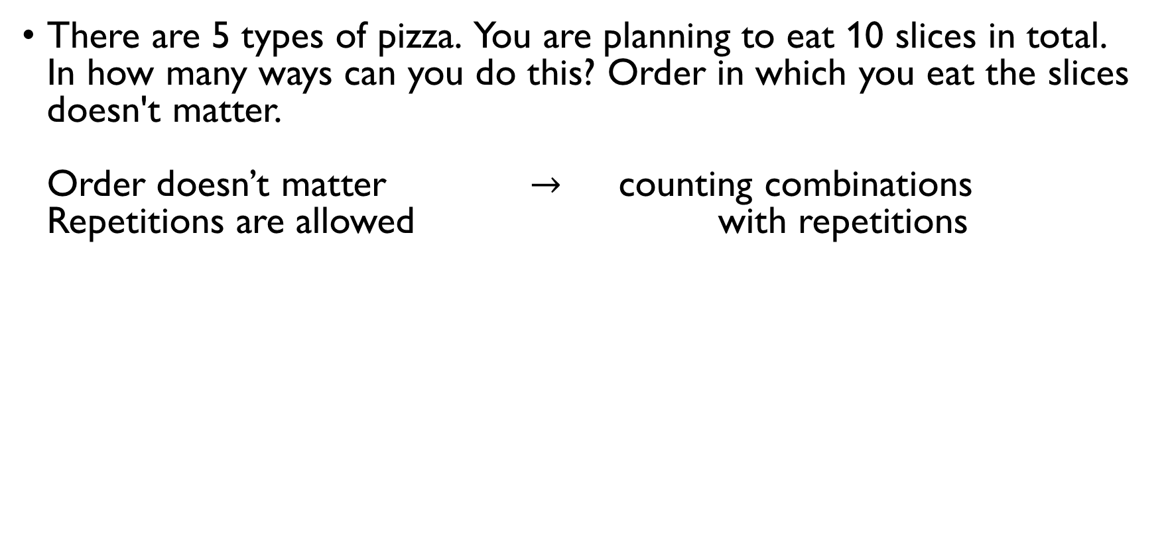
PIZZA
There are 5 types of pizza. You are planning to eat 10 slices in total. In how many ways can you do this? Order in which you eat the slices doesn't matter. Order doesn’t matter $→$ counting combinations Repetitions are allowed with repetitions
slices = “balls” types of pizza = “colour”, category
$C\left(10+5−1,5−1\right)=C\left(14,4\right)=\frac{14!}{10!4!}=\frac{14⋅13⋅12⋅11}{4!}=1001$ ways of eating 10 slices of pizza of 5 types

Slide 53
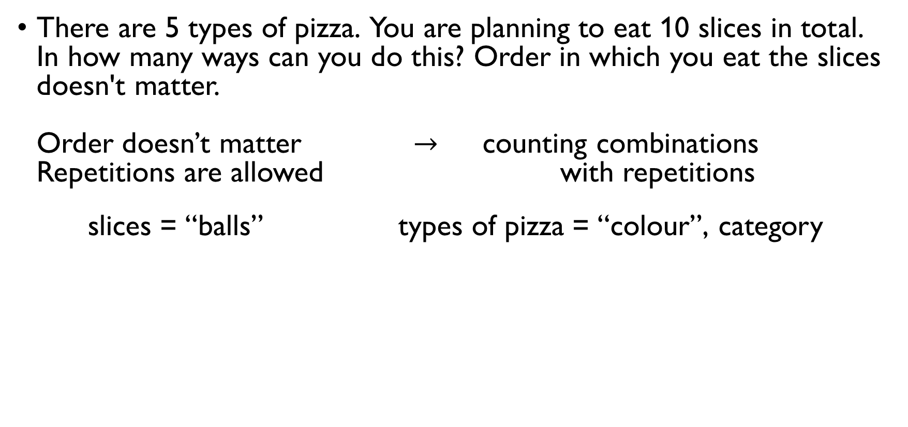
PIZZA
There are 5 types of pizza. You are planning to eat 10 slices in total. In how many ways can you do this? Order in which you eat the slices doesn't matter. Order doesn’t matter $→$ counting combinations Repetitions are allowed with repetitions
slices = “balls” types of pizza = “colour”, category
$C\left(10+5−1,5−1\right)=C\left(14,4\right)=\frac{14!}{10!4!}=\frac{14⋅13⋅12⋅11}{4!}=1001$ ways of eating 10 slices of pizza of 5 types

Slide 54
PIZZA
There are 5 types of pizza. You are planning to eat 10 slices in total. In how many ways can you do this? Order in which you eat the slices doesn't matter. Order doesn’t matter $→$ counting combinations Repetitions are allowed with repetitions
slices = “balls” types of pizza = “colour”, category
$C\left(10+5−1,5−1\right)=C\left(14,4\right)=\frac{14!}{10!4!}=\frac{14⋅13⋅12⋅11}{4!}=1001$ ways of eating 10 slices of pizza of 5 types

Slide 55
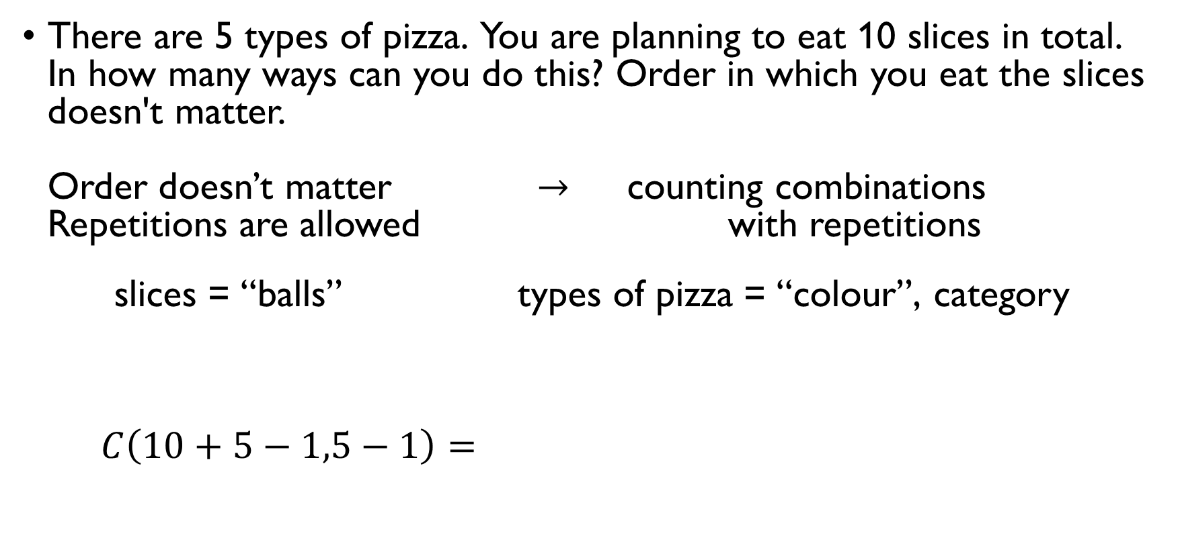
PIZZA
There are 5 types of pizza. You are planning to eat 10 slices in total. In how many ways can you do this? Order in which you eat the slices doesn't matter. Order doesn’t matter $→$ counting combinations Repetitions are allowed with repetitions
slices = “balls” types of pizza = “colour”, category
$C\left(10+5−1,5−1\right)=C\left(14,4\right)=\frac{14!}{10!4!}=\frac{14⋅13⋅12⋅11}{4!}=1001$ ways of eating 10 slices of pizza of 5 types

Slide 56
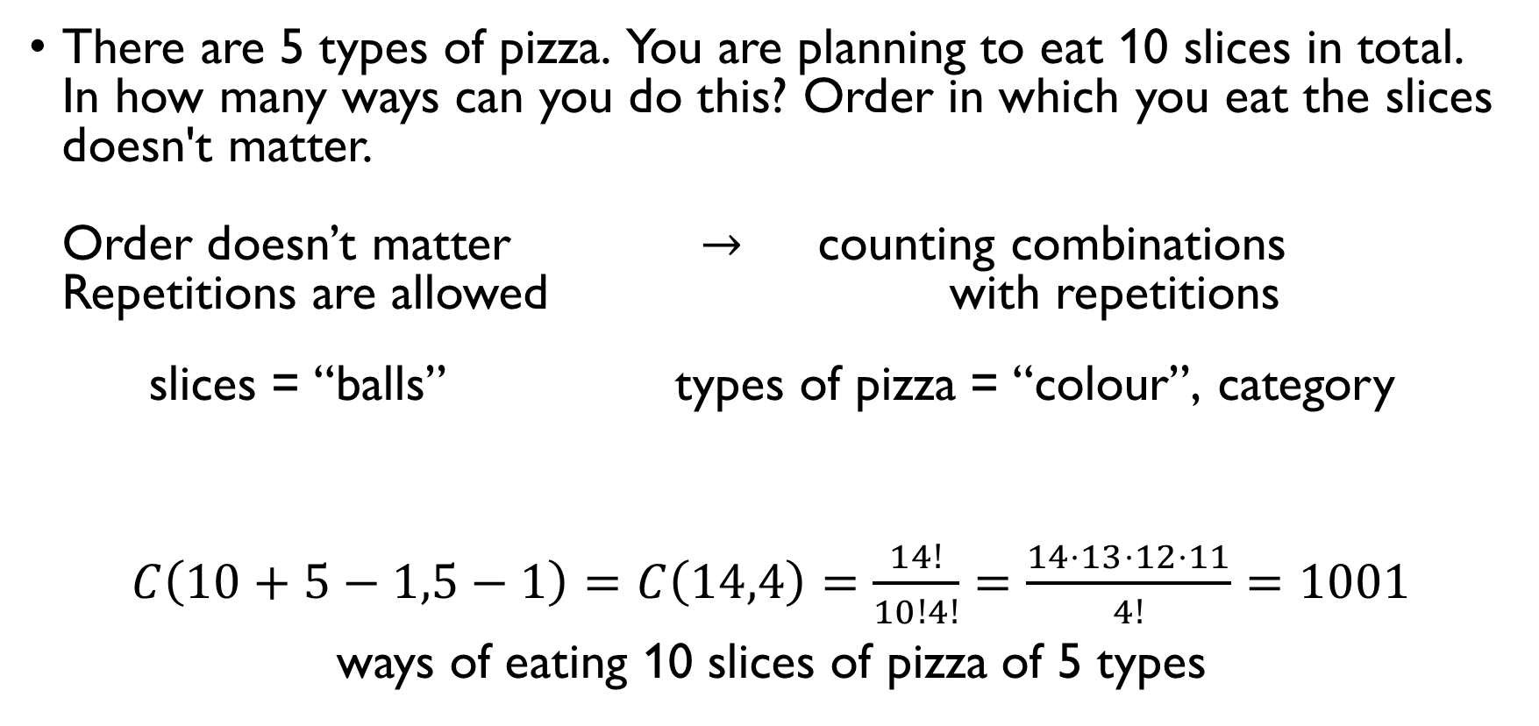
PIZZA
There are 5 types of pizza. You are planning to eat 10 slices in total. In how many ways can you do this? Order in which you eat the slices doesn't matter. Order doesn’t matter $→$ counting combinations Repetitions are allowed with repetitions
slices = “balls” types of pizza = “colour”, category
$C\left(10+5−1,5−1\right)=C\left(14,4\right)=\frac{14!}{10!4!}=\frac{14⋅13⋅12⋅11}{4!}=1001$ ways of eating 10 slices of pizza of 5 types

Slide 57
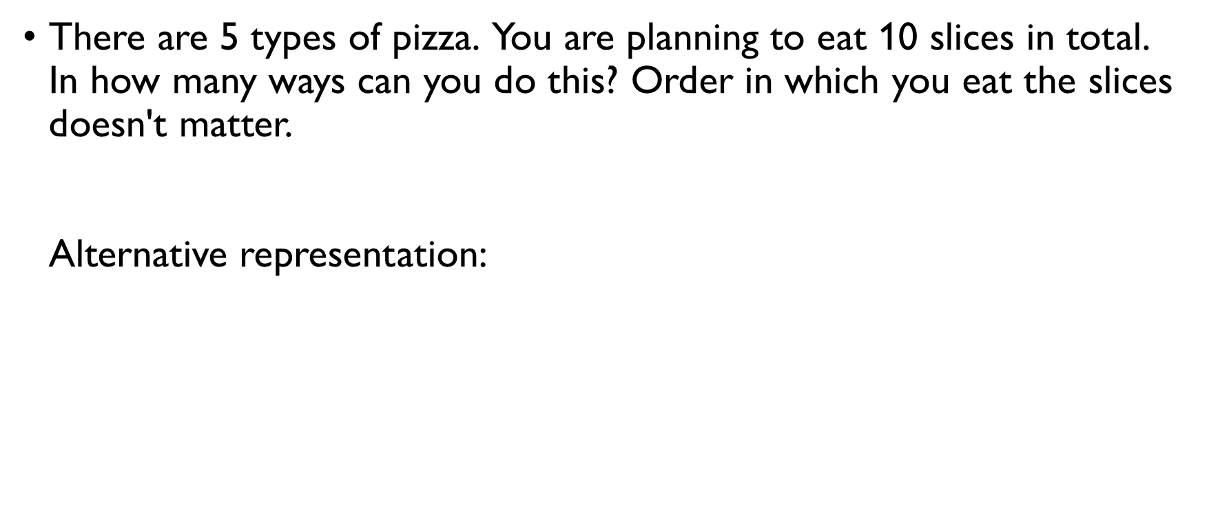
PIZZA
There are 5 types of pizza. You are planning to eat 10 slices in total. In how many ways can you do this? Order in which you eat the slices doesn't matter. Alternative representation: $x_{i}≥0−$ number of slices of pizza of type $i$. You are planning to eat 10 pieces, so
$$x_{1}+x_{2}+x_{3}+x_{4}+x_{5}=10$$

Slide 58
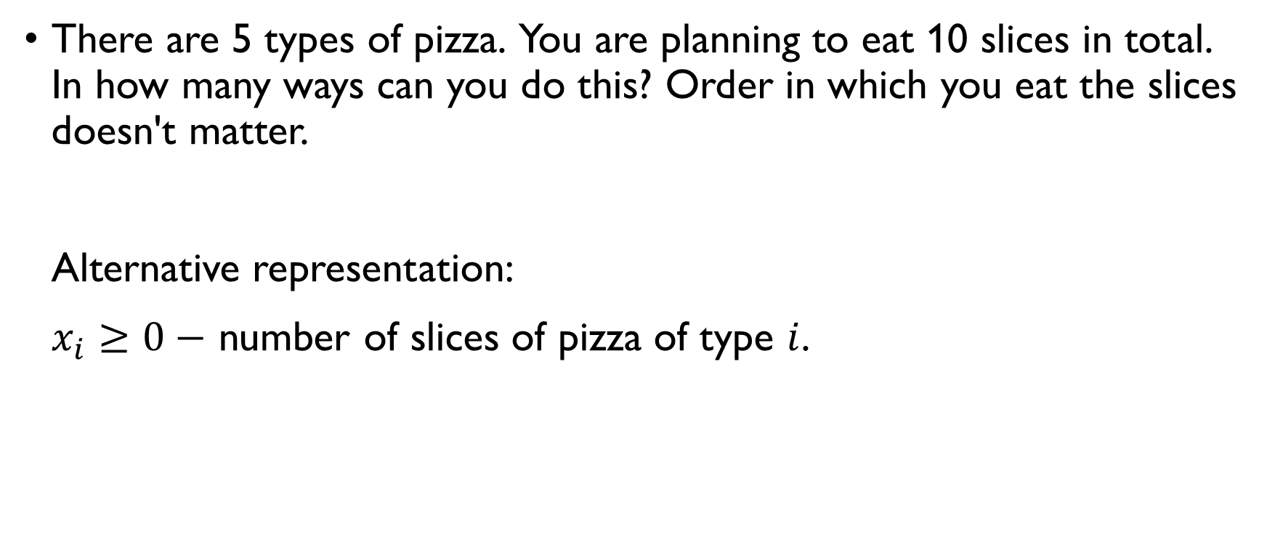
PIZZA
There are 5 types of pizza. You are planning to eat 10 slices in total. In how many ways can you do this? Order in which you eat the slices doesn't matter. Alternative representation: $x_{i}≥0−$ number of slices of pizza of type $i$. You are planning to eat 10 pieces, so
$$x_{1}+x_{2}+x_{3}+x_{4}+x_{5}=10$$

Slide 59
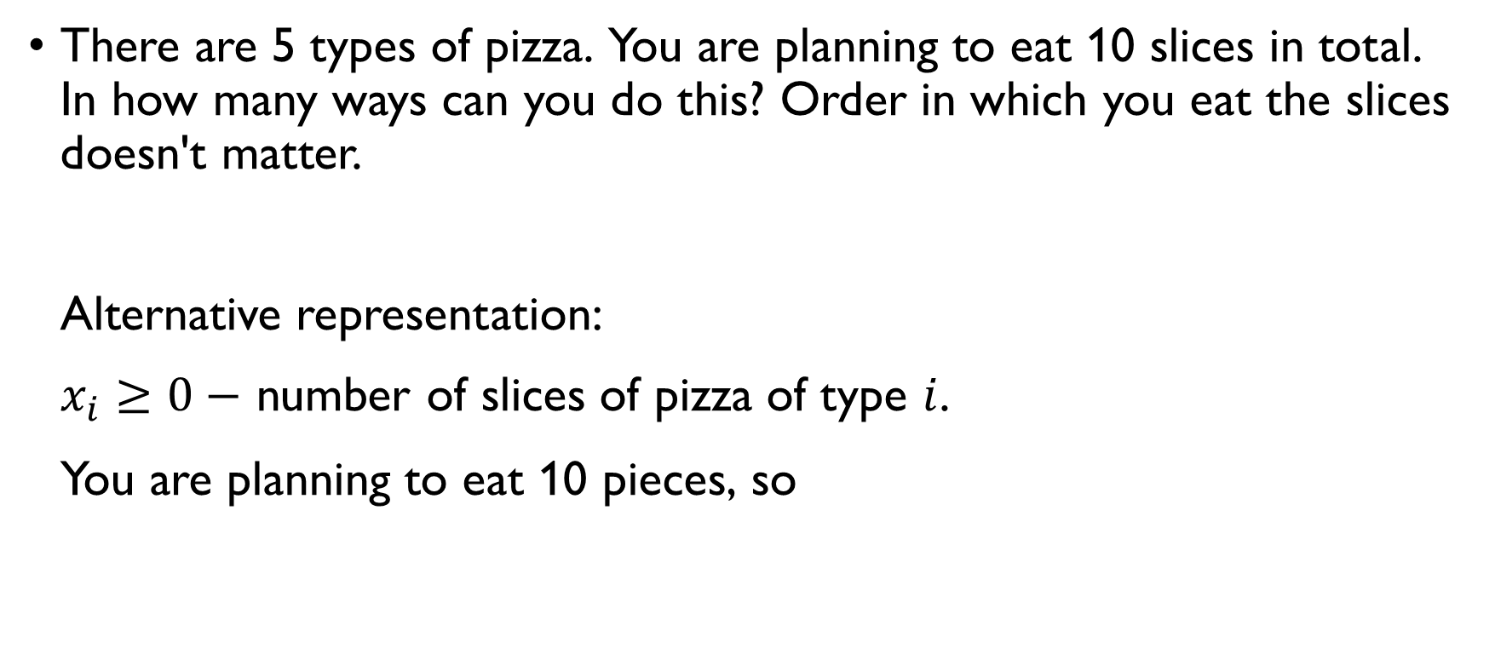
PIZZA
There are 5 types of pizza. You are planning to eat 10 slices in total. In how many ways can you do this? Order in which you eat the slices doesn't matter. Alternative representation: $x_{i}≥0−$ number of slices of pizza of type $i$. You are planning to eat 10 pieces, so
$$x_{1}+x_{2}+x_{3}+x_{4}+x_{5}=10$$

Slide 60
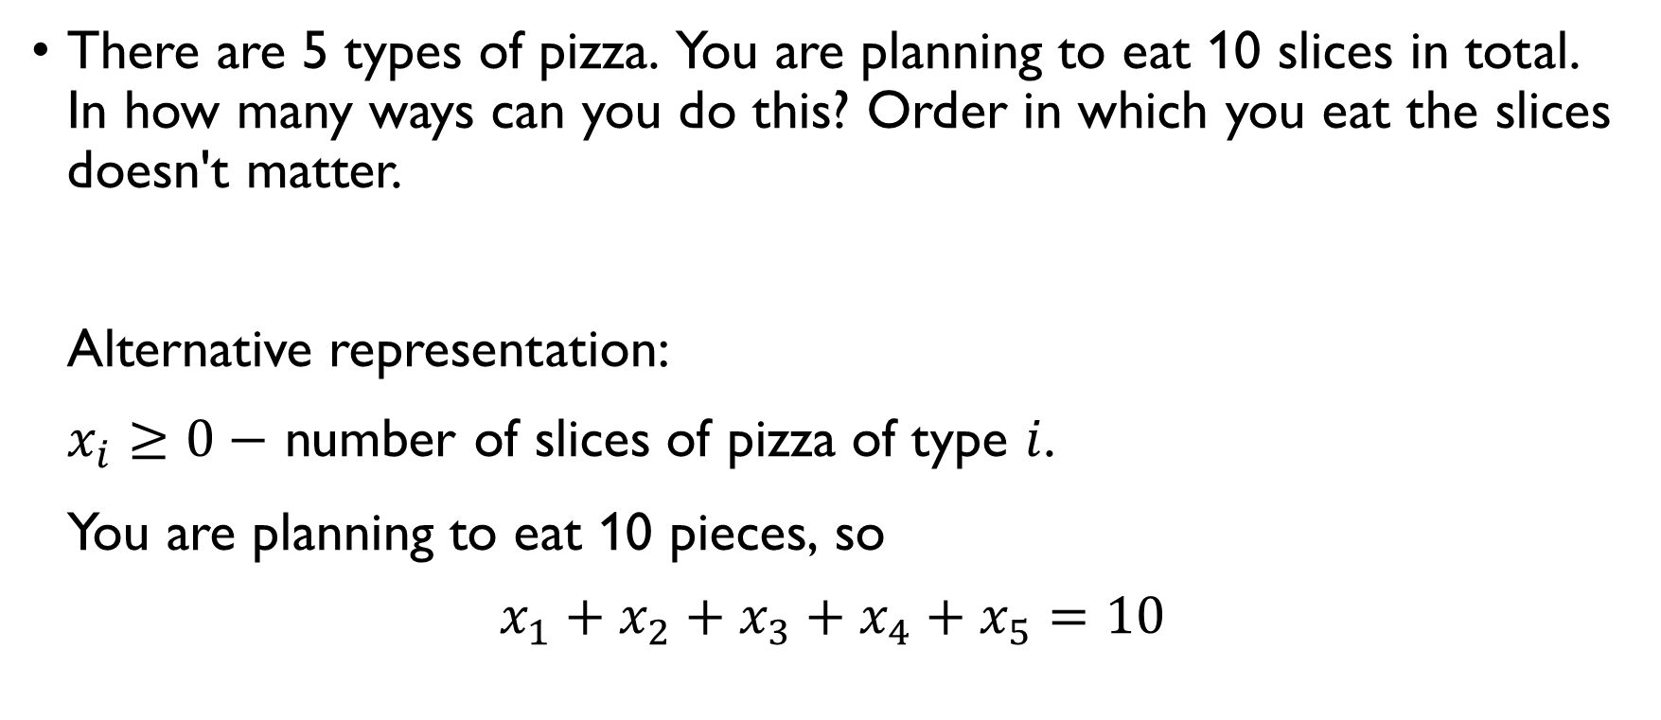
PIZZA
There are 5 types of pizza. You are planning to eat 10 slices in total. In how many ways can you do this? Order in which you eat the slices doesn't matter. Alternative representation: $x_{i}≥0−$ number of slices of pizza of type $i$. You are planning to eat 10 pieces, so
$$x_{1}+x_{2}+x_{3}+x_{4}+x_{5}=10$$

Slide 61

PIRATES
In how many ways can 6 pirates split 50 gold pieces?
$$x_{1}+x_{2}+x_{3}+x_{4}+x_{5}+x_{6}=50, x_{i}≥0$$
50 gold pieces = 50 “balls”, 6 pirates = 6 “colours”, “categories”
$C\left(50+6−1,6−1\right)=C\left(55,5\right)=\frac{55!}{5!50!}=\frac{55⋅54⋅53⋅52⋅51}{5⋅4⋅3⋅2}$ ways of distributing the gold without constraints

Slide 62

PIRATES
In how many ways can 6 pirates split 50 gold pieces?
$$x_{1}+x_{2}+x_{3}+x_{4}+x_{5}+x_{6}=50, x_{i}≥0$$
50 gold pieces = 50 “balls”, 6 pirates = 6 “colours”, “categories”
$C\left(50+6−1,6−1\right)=C\left(55,5\right)=\frac{55!}{5!50!}=\frac{55⋅54⋅53⋅52⋅51}{5⋅4⋅3⋅2}$ ways of distributing the gold without constraints

Slide 63

PIRATES
In how many ways can 6 pirates split 50 gold pieces?
$$x_{1}+x_{2}+x_{3}+x_{4}+x_{5}+x_{6}=50, x_{i}≥0$$
50 gold pieces = 50 “balls”, 6 pirates = 6 “colours”, “categories”
$C\left(50+6−1,6−1\right)=C\left(55,5\right)=\frac{55!}{5!50!}=\frac{55⋅54⋅53⋅52⋅51}{5⋅4⋅3⋅2}$ ways of distributing the gold without constraints

Slide 64

PIRATES
In how many ways can 6 pirates split 50 gold pieces?
$$x_{1}+x_{2}+x_{3}+x_{4}+x_{5}+x_{6}=50, x_{i}≥0$$
50 gold pieces = 50 “balls”, 6 pirates = 6 “colours”, “categories”
$C\left(50+6−1,6−1\right)=C\left(55,5\right)=\frac{55!}{5!50!}=\frac{55⋅54⋅53⋅52⋅51}{5⋅4⋅3⋅2}$ ways of distributing the gold without constraints

Slide 65

PIRATES
In how many ways can 6 pirates split 50 gold pieces?
$$x_{1}+x_{2}+x_{3}+x_{4}+x_{5}+x_{6}=50, x_{i}≥0$$
50 gold pieces = 50 “balls”, 6 pirates = 6 “colours”, “categories”
$C\left(50+6−1,6−1\right)=C\left(55,5\right)=\frac{55!}{5!50!}=\frac{55⋅54⋅53⋅52⋅51}{5⋅4⋅3⋅2}$ ways of distributing the gold without constraints

Slide 66

PIRATES
In how many ways can 6 pirates split 50 gold pieces if the first pirate needs at least 10 pieces, the second needs at least 8, the third needs at least 6, the fourth needs at least 4, and the fifth needs at least 2, and the sixth can get any amount?
$$x_{1}+x_{2}+x_{3}+x_{4}+x_{5}+x_{6}=50,$$
$$x_{1}≥10, x_{2}≥8, x_{3}≥4, x_{5}≥2, x_{6}≥0$$
$$y_{1}=x_{1}−10, y_{2}=x_{2}−8, y_{3}=x_{3}−4, y_{4}=x_{4}−2, y_{5}=x_{5}−2, y_{6}=x_{6}, y_{i}≥0$$
$$y_{1}+10+y_{2}+8+y_{3}+4+y_{5}+2+y_{6}=50$$

Slide 67

PIRATES
In how many ways can 6 pirates split 50 gold pieces if the first pirate needs at least 10 pieces, the second needs at least 8, the third needs at least 6, the fourth needs at least 4, and the fifth needs at least 2, and the sixth can get any amount?
$$x_{1}+x_{2}+x_{3}+x_{4}+x_{5}+x_{6}=50,$$
$$x_{1}≥10, x_{2}≥8, x_{3}≥4, x_{5}≥2, x_{6}≥0$$
$$y_{1}=x_{1}−10, y_{2}=x_{2}−8, y_{3}=x_{3}−4, y_{4}=x_{4}−2, y_{5}=x_{5}−2, y_{6}=x_{6}, y_{i}≥0$$
$$y_{1}+10+y_{2}+8+y_{3}+4+y_{5}+2+y_{6}=50$$

Slide 68

PIRATES
In how many ways can 6 pirates split 50 gold pieces if the first pirate needs at least 10 pieces, the second needs at least 8, the third needs at least 6, the fourth needs at least 4, and the fifth needs at least 2, and the sixth can get any amount?
$$x_{1}+x_{2}+x_{3}+x_{4}+x_{5}+x_{6}=50,$$
$$x_{1}≥10, x_{2}≥8, x_{3}≥4, x_{5}≥2, x_{6}≥0$$
$$y_{1}=x_{1}−10, y_{2}=x_{2}−8, y_{3}=x_{3}−4, y_{4}=x_{4}−2, y_{5}=x_{5}−2, y_{6}=x_{6}, y_{i}≥0$$
$$y_{1}+10+y_{2}+8+y_{3}+4+y_{5}+2+y_{6}=50$$

Slide 69

PIRATES
In how many ways can 6 pirates split 50 gold pieces if the first pirate needs at least 10 pieces, the second needs at least 8, the third needs at least 6, the fourth needs at least 4, and the fifth needs at least 2, and the sixth can get any amount?
$$x_{1}+x_{2}+x_{3}+x_{4}+x_{5}+x_{6}=50,$$
$$x_{1}≥10, x_{2}≥8, x_{3}≥4, x_{5}≥2, x_{6}≥0$$
$$y_{1}=x_{1}−10, y_{2}=x_{2}−8, y_{3}=x_{3}−4, y_{4}=x_{4}−2, y_{5}=x_{5}−2, y_{6}=x_{6}, y_{i}≥0$$
$$y_{1}+10+y_{2}+8+y_{3}+4+y_{5}+2+y_{6}=50$$

Slide 70

PIRATES
In how many ways can 6 pirates split 50 gold pieces if the first pirate needs at least 10 pieces, the second needs at least 8, the third needs at least 6, the fourth needs at least 4, and the fifth needs at least 2, and the sixth can get any amount?
$$x_{1}+x_{2}+x_{3}+x_{4}+x_{5}+x_{6}=50,$$
$$x_{1}≥10, x_{2}≥8, x_{3}≥4, x_{5}≥2, x_{6}≥0$$
$$y_{1}=x_{1}−10, y_{2}=x_{2}−8, y_{3}=x_{3}−6, y_{4}=x_{4}−4, y_{5}=x_{5}−2, y_{6}=x_{6}, y_{i}≥0$$
$$y_{1}+10+y_{2}+8+y_{3}+6+y_{4}+4+y_{5}+2+y_{6}=50$$

Slide 71

PIRATES
In how many ways can 6 pirates split 50 gold pieces if the first pirate needs at least 10 pieces, the second needs at least 8, the third needs at least 6, the fourth needs at least 4, and the fifth needs at least 2, and the sixth can get any amount?
$$y_{1}+y_{2}+y_{3}+y_{4}+y_{5}+y_{6}=20, y_{i}≥0$$
26 “balls”, 6 “colours”
$C\left(26+6−1,6−1\right)=C\left(31,5\right)=\frac{31!}{5!26!}=\frac{31⋅30⋅29⋅28⋅27}{5!}$ ways of distributing the gold with constraints above

Slide 72

PIRATES
In how many ways can 6 pirates split 50 gold pieces if the first pirate needs at least 10 pieces, the second needs at least 8, the third needs at least 6, the fourth needs at least 4, and the fifth needs at least 2, and the sixth can get any amount?
$$y_{1}+y_{2}+y_{3}+y_{4}+y_{5}+y_{6}=20, y_{i}≥0$$
20 “balls”, 6 “colours”
$C\left(26+6−1,6−1\right)=C\left(31,5\right)=\frac{31!}{5!26!}=\frac{31⋅30⋅29⋅28⋅27}{5!}$ ways of distributing the gold with constraints above

Slide 73

PIRATES
In how many ways can 6 pirates split 50 gold pieces if the first pirate needs at least 10 pieces, the second needs at least 8, the third needs at least 6, the fourth needs at least 4, and the fifth needs at least 2, and the sixth can get any amount?
$$y_{1}+y_{2}+y_{3}+y_{4}+y_{5}+y_{6}=20, y_{i}≥0$$
20 “balls”, 6 “colours”
$C\left(20+6−1,6−1\right)=C\left(31,5\right)=\frac{31!}{5!26!}=\frac{31⋅30⋅29⋅28⋅27}{5!}$ ways of distributing the gold with constraints above

Slide 74

PIRATES
In how many ways can 6 pirates split 50 gold pieces if the first pirate needs at least 10 pieces, the second needs at least 8, the third needs at least 6, the fourth needs at least 4, and the fifth needs at least 2, and the sixth can get any amount?
$$y_{1}+y_{2}+y_{3}+y_{4}+y_{5}+y_{6}=20, y_{i}≥0$$
20 “balls”, 6 “colours”
$C\left(20+6−1,6−1\right)=C\left(26,5\right)=\frac{25!}{5!20!}=\frac{25⋅24⋅23⋅22⋅21}{5!}$ ways of distributing the gold with constraints above

Slide 75

STUDENTS and assignments
There are 4 students and 9 different assignments. Each student should receive exactly one assignment. Assignments for different students should be different. How many ways are there to do it?
Different assignments for different students $→$ order matters, no repetitions
$$9⋅8⋅7⋅6=\frac{9!}{\left(9−4\right)!}$$

Slide 76

STUDENTS and assignments
There are 4 students and 9 different assignments. Each student should receive exactly one assignment. Assignments for different students should be different. How many ways are there to do it?
Different assignments for different students $→$ order matters, no repetitions
$$9⋅8⋅7⋅6=\frac{9!}{\left(9−4\right)!}$$

Slide 77

STUDENTS and assignments
There are 4 students and 9 different assignments. Each student should receive exactly one assignment. Assignments for different students should be different. How many ways are there to do it?
Different assignments for different students $→$ order matters, no repetitions
$$9⋅8⋅7⋅6=\frac{9!}{\left(9−4\right)!}$$

Slide 78

STUDENTS and assignments
There are 4 students and 9 different assignments. Each student should receive exactly one assignment. Assignments for different students should be different. How many ways are there to do it?
Different assignments for different students $→$ order matters, no repetitions
$$9⋅8⋅7⋅6=\frac{9!}{\left(9−4\right)!}$$

Slide 79

STUDENTS and assignments
There are 4 students and 9 different assignments. We need to distribute all the assignments among the students. Every student can receive an arbitrary number of assignments from 0 to 9, no assignment should be assigned to two people. How many ways are there to do it?
Different assignments for different students $→$ order matters, no repetitions.
Let’s look at this problem from the position of the assignments:
$4⋅4⋅4⋅4⋅4⋅4⋅4⋅4⋅4=4^{9}$ ways of distributing different assignments between different students

Slide 80

STUDENTS and assignments
There are 4 students and 9 different assignments. We need to distribute all the assignments among the students. Every student can receive an arbitrary number of assignments from 0 to 9, no assignment should be assigned to two people. How many ways are there to do it?
Different assignments for different students $→$ order matters, no repetitions.
Let’s look at this problem from the position of the assignments:
$4⋅4⋅4⋅4⋅4⋅4⋅4⋅4⋅4=4^{9}$ ways of distributing different assignments between different students

Slide 81

STUDENTS and assignments
There are 4 students and 9 different assignments. We need to distribute all the assignments among the students. Every student can receive an arbitrary number of assignments from 0 to 9, no assignment should be assigned to two people. How many ways are there to do it?
Different assignments for different students $→$ order matters.
Let’s look at this problem from the position of the assignments:
$4⋅4⋅4⋅4⋅4⋅4⋅4⋅4⋅4=4^{9}$ ways of distributing different assignments between different students

Slide 82

STUDENTS and assignments
There are 4 students and 9 different assignments. We need to distribute all the assignments among the students. Every student can receive an arbitrary number of assignments from 0 to 9, no assignment should be assigned to two people. How many ways are there to do it?
Different assignments for different students $→$ order matters.
Let’s look at this problem from the position of the assignments:
$4⋅4⋅4⋅4⋅4⋅4⋅4⋅4⋅4=4^{9}$ ways of distributing different assignments between different students

Slide 83

STUDENTS and assignments
There are 4 students and 9 different assignments. We need to distribute all the assignments among the students. Every student can receive an arbitrary number of assignments from 0 to 9, no assignment should be assigned to two people. How many ways are there to do it?
Different assignments for different students $→$ order matters.
Let’s look at this problem from the position of the assignments:
$4⋅4⋅4⋅4⋅4⋅4⋅4⋅4⋅4=4^{9}$ ways of distributing different assignments between different students

Slide 84
STUDENTS and assignments
There are 4 students and 9 different assignments. We need to distribute all the assignments among the students. Every student can receive an arbitrary number of assignments from 0 to 9, no assignment should be assigned to two people. How many ways are there to do it?
What would make it a “combinations with repetitions” problem?
indistinguishable students (no ordering)
indistinguishable assignments (repetitions)

Slide 85
STUDENTS and assignments
There are 4 students and 9 different assignments. We need to distribute all the assignments among the students. Every student can receive an arbitrary number of assignments from 0 to 9, no assignment should be assigned to two people. How many ways are there to do it?
What would make it a “combinations with repetitions” problem?
indistinguishable students (no ordering)
indistinguishable assignments (repetitions)

Slide 86

candies
There are 15 identical candies. In how many ways can you distribute them among 7 kids?
Identical candies $→$ repetitions allowed, order doesn’t matter $→$ combinations with repetitions 15 candies = 15 balls, 7 kids = 7 colours, categories
$$C\left(15+7−1, 7−1\right)=C\left(21,6\right)=\frac{21!}{6!15!}=54264$$ ways of distributing the candies among the kids with no constraints

Slide 87

candies
There are 15 identical candies. In how many ways can you distribute them among 7 kids?
Identical candies $→$ repetitions allowed, order doesn’t matter $→$ combinations with repetitions 15 candies = 15 balls, 7 kids = 7 colours, categories
$$C\left(15+7−1, 7−1\right)=C\left(21,6\right)=\frac{21!}{6!15!}=54264$$ ways of distributing the candies among the kids with no constraints

Slide 88

candies
There are 15 identical candies. In how many ways can you distribute them among 7 kids?
Identical candies $→$ repetitions allowed, order doesn’t matter $→$ combinations with repetitions 15 candies = 15 balls, 7 kids = 7 colours, categories
$$C\left(15+7−1, 7−1\right)=C\left(21,6\right)=\frac{21!}{6!15!}=54264$$ ways of distributing the candies among the kids with no constraints

Slide 89

candies
There are 15 identical candies. In how many ways can you distribute them among 7 kids?
Identical candies $→$ repetitions allowed, order doesn’t matter $→$ combinations with repetitions 15 candies = 15 balls, 7 kids = 7 colours, categories
$$C\left(15+7−1, 7−1\right)=C\left(21,6\right)=\frac{21!}{6!15!}=54264$$ ways of distributing the candies among the kids with no constraints

Slide 90

candies
There are 15 identical candies. In how many ways can you distribute them among 7 kids?
Identical candies $→$ repetitions allowed, order doesn’t matter $→$ combinations with repetitions 15 candies = 15 balls, 7 kids = 7 colours, categories
$$C\left(15+7−1, 7−1\right)=C\left(21,6\right)=\frac{21!}{6!15!}=54264$$ ways of distributing the candies among the kids with no constraints

Slide 91

candies
There are 15 identical candies. In how many ways can you distribute them among 7 kids?
Identical candies $→$ repetitions allowed, order doesn’t matter $→$ combinations with repetitions 15 candies = 15 balls, 7 kids = 7 colours, categories
$$C\left(15+7−1, 7−1\right)=C\left(21,6\right)=\frac{21!}{6!15!}=54264$$ ways of distributing the candies among the kids with no constraints

Slide 92

candies
There are 15 identical candies. In how many ways can you distribute them among 7 kids so that each kid gets at least one candy?
Let’s give one candy to every kid to satisfy the condition. Now we need to distribute the rest:
15 – 7 = 8 candies = 8 balls, 7 kids = 7 colours, categories
$C\left(8+7−1,7−1\right)=C\left(14,6\right)=\frac{14!}{6!8!}=3003$ ways of distributing the candies among the kid so that everyone gets at least one candy

Slide 93

candies
There are 15 identical candies. In how many ways can you distribute them among 7 kids so that each kid gets at least one candy?
Let’s give one candy to every kid to satisfy the condition. Now we need to distribute the rest:
15 – 7 = 8 candies = 8 balls, 7 kids = 7 colours, categories
$C\left(8+7−1,7−1\right)=C\left(14,6\right)=\frac{14!}{6!8!}=3003$ ways of distributing the candies among the kid so that everyone gets at least one candy

Slide 94

candies
There are 15 identical candies. In how many ways can you distribute them among 7 kids so that each kid gets at least one candy?
Let’s give one candy to every kid to satisfy the condition. Now we need to distribute the rest:
15 – 7 = 8 candies = 8 balls, 7 kids = 7 colours, categories
$C\left(8+7−1,7−1\right)=C\left(14,6\right)=\frac{14!}{6!8!}=3003$ ways of distributing the candies among the kid so that everyone gets at least one candy

Slide 95

candies
There are 15 identical candies. In how many ways can you distribute them among 7 kids so that each kid gets at least one candy?
Let’s give one candy to every kid to satisfy the condition. Now we need to distribute the rest:
15 – 7 = 8 candies = 8 balls, 7 kids = 7 colours, categories
$C\left(8+7−1,7−1\right)=C\left(14,6\right)=\frac{14!}{6!8!}=3003$ ways of distributing the candies among the kid so that everyone gets at least one candy

Slide 96

candies
There are 15 identical candies. In how many ways can you distribute them among 7 kids so that each kid gets at least one candy?
Let’s give one candy to every kid to satisfy the condition. Now we need to distribute the rest:
15 – 7 = 8 candies = 8 balls, 7 kids = 7 colours, categories
$C\left(8+7−1,7−1\right)=C\left(14,6\right)=\frac{14!}{6!8!}=3003$ ways of distributing the candies among the kid so that everyone gets at least one candy

Slide 97

candies
There are 15 identical candies. In how many ways can you distribute them among 7 kids so that each kid gets at least one candy?
Let’s give one candy to every kid to satisfy the condition. Now we need to distribute the rest:
15 – 7 = 8 candies = 8 balls, 7 kids = 7 colours, categories
$C\left(8+7−1,7−1\right)=C\left(14,6\right)=\frac{14!}{6!8!}=3003$ ways of distributing the candies among the kid so that everyone gets at least one candy

Slide 98

Working groups
There are 12 students in the class. How many ways are there to split them into working groups of size 2 to work on the same assignment?
Order within groups doesn’t matter $→$ combinations
$$C\left(12,2\right)⋅C\left(10,2\right)⋅C\left(8,2\right)⋅C\left(6,2\right)⋅C\left(4,2\right)⋅C\left(2,2\right)=\frac{12!}{{\left(2!\right)}^{6}}$$
But the groups are unordered! We counted every split 6! times, fixing it:
$\frac{12!}{{6!\left(2!\right)}^{6}}=10395$ possible splits

Slide 99

Working groups
There are 12 students in the class. How many ways are there to split them into working groups of size 2 to work on the same assignment?
Order within groups doesn’t matter $→$ combinations
$$C\left(12,2\right)⋅C\left(10,2\right)⋅C\left(8,2\right)⋅C\left(6,2\right)⋅C\left(4,2\right)⋅C\left(2,2\right)=\frac{12!}{{\left(2!\right)}^{6}}$$
But the groups are unordered! We counted every split 6! times, fixing it:
$\frac{12!}{{6!\left(2!\right)}^{6}}=10395$ possible splits

Slide 100

Working groups
There are 12 students in the class. How many ways are there to split them into working groups of size 2 to work on the same assignment?
Order within groups doesn’t matter $→$ combinations
$$C\left(12,2\right)⋅C\left(10,2\right)⋅C\left(8,2\right)⋅C\left(6,2\right)⋅C\left(4,2\right)⋅C\left(2,2\right)=\frac{12!}{{\left(2!\right)}^{6}}$$
But the groups are unordered! We counted every split 6! times, fixing it:
$\frac{12!}{{6!\left(2!\right)}^{6}}=10395$ possible splits

Slide 101

Working groups
There are 12 students in the class. How many ways are there to split them into working groups of size 2 to work on the same assignment?
Order within groups doesn’t matter $→$ combinations
$$C\left(12,2\right)⋅C\left(10,2\right)⋅C\left(8,2\right)⋅C\left(6,2\right)⋅C\left(4,2\right)⋅C\left(2,2\right)=\frac{12!}{{\left(2!\right)}^{6}}$$
But the groups are unordered! We counted every split 6! times, fixing it:
$\frac{12!}{{6!\left(2!\right)}^{6}}=10395$ possible splits

Slide 102

Working groups
There are 12 students in the class. How many ways are there to split them into working groups of size 2 to work on the same assignment?
Order within groups doesn’t matter $→$ combinations
$$C\left(12,2\right)⋅C\left(10,2\right)⋅C\left(8,2\right)⋅C\left(6,2\right)⋅C\left(4,2\right)⋅C\left(2,2\right)=\frac{12!}{{\left(2!\right)}^{6}}$$
But the groups are unordered! We counted every split 6! times, fixing it:
$\frac{12!}{{6!\left(2!\right)}^{6}}=10395$ possible splits

Slide 103

Working groups
There are 12 students in the class. How many ways are there to split them into working groups of size 2 to work on the same assignment?
Order within groups doesn’t matter $→$ combinations
$$C\left(12,2\right)⋅C\left(10,2\right)⋅C\left(8,2\right)⋅C\left(6,2\right)⋅C\left(4,2\right)⋅C\left(2,2\right)=\frac{12!}{{\left(2!\right)}^{6}}$$
But the groups are unordered! We counted every split 6! times, fixing it:
$\frac{12!}{{6!\left(2!\right)}^{6}}=10395$ possible splits

Slide 104

Working groups
There are 12 students in the class. How many ways are there to split them into working groups of size 2 to work on the same assignment?
Order within groups doesn’t matter $→$ combinations
$$C\left(12,2\right)⋅C\left(10,2\right)⋅C\left(8,2\right)⋅C\left(6,2\right)⋅C\left(4,2\right)⋅C\left(2,2\right)=\frac{12!}{{\left(2!\right)}^{6}}$$
But the groups are unordered! We counted every split 6! times, fixing it:
$\frac{12!}{{6!\left(2!\right)}^{6}}=10395$ possible splits

Slide 105

THE PIGEONHOLE PRINCIPLE

Slide 106

THE PIGEONHOLE PRINCIPLE
If $n$ or more pigeons are distributed among $k$ pigeonholes and $n>k$, then at least one pigeonhole contains two or more pigeons.

Slide 107

Birthdays 1
What should be the minimal number of people in the class so that we can guarantee that at least two students were born in the same month?
Students = pigeons, months = holes
There are $k=12$ months.
If there are $n>k$ students, at least two of them are born in the same month.
Therefore, there must be at least 13 students.

Slide 108

Birthdays 1
What should be the minimal number of people in the class so that we can guarantee that at least two students were born in the same month?
Students = pigeons, months = holes
There are $k=12$ months.
If there are $n>k$ students, at least two of them are born in the same month.
Therefore, there must be at least 13 students.

Slide 109

Birthdays 1
What should be the minimal number of people in the class so that we can guarantee that at least two students were born in the same month?
Students = pigeons, months = holes
There are $k=12$ months.
If there are $n>k$ students, at least two of them are born in the same month.
Therefore, there must be at least 13 students.

Slide 110

Birthdays 1
What should be the minimal number of people in the class so that we can guarantee that at least two students were born in the same month?
Students = pigeons, months = holes
There are $k=12$ months.
If there are $n>k$ students, at least two of them are born in the same month.
Therefore, there must be at least 13 students.

Slide 111

Birthdays 1
What should be the minimal number of people in the class so that we can guarantee that at least two students were born in the same month?
Students = pigeons, months = holes
There are $k=12$ months.
If there are $n>k$ students, at least two of them are born in the same month.
Therefore, there must be at least 13 students.

Slide 112

Birthdays 2
How many people there should be in the room to guarantee that two people have birthday on the same day?
People = pigeons, days = holes
There are $k=366$ days.
If there are $n>k$ people, at least two of them are born in the same month.
Therefore, there must be at least 367 people.

Slide 113

Birthdays 2
How many people there should be in the room to guarantee that two people have birthday on the same day?
People = pigeons, days = holes
There are $k=366$ days.
If there are $n>k$ people, at least two of them are born in the same month.
Therefore, there must be at least 367 people.

Slide 114

Birthdays 2
How many people there should be in the room to guarantee that two people have birthday on the same day?
People = pigeons, days = holes
There are $k=366$ days.
If there are $n>k$ people, at least two of them are born in the same month.
Therefore, there must be at least 367 people.

Slide 115

Birthdays 2
How many people there should be in the room to guarantee that two people have birthday on the same day?
People = pigeons, days = holes
There are $k=366$ days.
If there are $n>k$ people, at least two of them are born in the same month.
Therefore, there must be at least 367 people.

Slide 116

Birthdays 2
How many people there should be in the room to guarantee that two people have birthday on the same day?
People = pigeons, days = holes
There are $k=366$ days.
If there are $n>k$ people, at least two of them are born in the same month.
Therefore, there must be at least 367 people.

Slide 117

numbers
Prove that if seven distinct numbers are selected from $\{1,2,…,11\}$, then some two of these numbers sum to $12$. We can split the numbers into the following sets:
$$\left\{1, 11\right\}, \left\{2, 10\right\}, \left\{3, 9\right\}, \left\{4, 8\right\}, \left\{5, 7\right\}, \{6\}$$
Those are our $k=6$ holes. $n=7>k$ numbers are selected. At least two of them will belong to the same set, meaning that at least two of them will sum up to 12.

Slide 118

numbers
Prove that if seven distinct numbers are selected from $\{1,2,…,11\}$, then some two of these numbers sum to $12$. We can split the numbers into the following sets:
$$\left\{1, 11\right\}, \left\{2, 10\right\}, \left\{3, 9\right\}, \left\{4, 8\right\}, \left\{5, 7\right\}, \{6\}$$
Those are our $k=6$ holes. $n=7>k$ numbers are selected. At least two of them will belong to the same set, meaning that at least two of them will sum up to 12.

Slide 119

numbers
Prove that if seven distinct numbers are selected from $\{1,2,…,11\}$, then some two of these numbers sum to $12$. We can split the numbers into the following sets:
$$\left\{1, 11\right\}, \left\{2, 10\right\}, \left\{3, 9\right\}, \left\{4, 8\right\}, \left\{5, 7\right\}, \{6\}$$
Those are our $k=6$ holes. $n=7>k$ numbers are selected. At least two of them will belong to the same set, meaning that at least two of them will sum up to 12.

Slide 120

numbers
Prove that if seven distinct numbers are selected from $\{1,2,…,11\}$, then some two of these numbers sum to $12$. We can split the numbers into the following sets:
$$\left\{1, 11\right\}, \left\{2, 10\right\}, \left\{3, 9\right\}, \left\{4, 8\right\}, \left\{5, 7\right\}, \{6\}$$
Those are our $k=6$ holes. $n=7>k$ numbers are selected. At least two of them will belong to the same set, meaning that at least two of them will sum up to 12.

Slide 121

numbers
Prove that if seven distinct numbers are selected from $\{1,2,…,11\}$, then some two of these numbers sum to $12$. We can split the numbers into the following sets:
$$\left\{1, 11\right\}, \left\{2, 10\right\}, \left\{3, 9\right\}, \left\{4, 8\right\}, \left\{5, 7\right\}, \{6\}$$
Those are our $k=6$ holes. $n=7>k$ numbers are selected. At least two of them will belong to the same set, meaning that at least two of them will sum up to 12.

Slide 122


Generalized pigeonhole principle
Given $n$ items that fall into $k$ different categories, if $n > m⋅k$for some positive integer $m$, then at least $m+1$ of the items must fall into the same category.

Slide 123

Breakout rooms
Given $n$ items that fall into $k$ different categories, if $n > m⋅k$for some positive integer $m$, then at least $m+1$ of the items must fall into the same category. Example:
There are $n = 5$people in this class.
$k=2$ breakout rooms are created.
$n > 2⋅k=4 ⟹$ at least $2+1 = 3$students will be put in the same breakout room.

Slide 124

Breakout rooms
Given $n$ items that fall into $k$ different categories, if $n > m⋅k$for some positive integer $m$, then at least $m+1$ of the items must fall into the same category. Example:
There are $n = 5$people in this class.
$k=2$ breakout rooms are created.
$n > 2⋅k=4 ⟹$ at least $2+1 = 3$students will be put in the same breakout room.

Slide 125

Breakout rooms
Given $n$ items that fall into $k$ different categories, if $n > m⋅k$for some positive integer $m$, then at least $m+1$ of the items must fall into the same category. Example:
There are $n = 5$people in this class.
$k=2$ breakout rooms are created.
$n > 2⋅k=4 ⟹$ at least $2+1 = 3$students will be put in the same breakout room.

Slide 126

test
30 students participated in an exam. The worst student in class got 13 answers wrong, while others made fewer mistakes. Show that there are at least 3 students who all made the same number of mistakes.
Students = pigeons, number of mistakes = pigeonholes $$30>2⋅13$$
According to the generalized pigeonhole principle, at least $2+1=3$ students must have received the same score.

Slide 127

test
30 students participated in an exam. The worst student in class got 13 answers wrong, while others made fewer mistakes. Show that there are at least 3 students who all made the same number of mistakes.
Students = pigeons, number of mistakes = pigeonholes $$30>2⋅13$$
According to the generalized pigeonhole principle, at least $2+1=3$ students must have received the same score.

Slide 128

test
30 students participated in an exam. The worst student in class got 13 answers wrong, while others made fewer mistakes. Show that there are at least 3 students who all made the same number of mistakes.
Students = pigeons, number of mistakes = pigeonholes $$30>2⋅13$$
According to the generalized pigeonhole principle, at least $2+1=3$ students must have received the same score.

Slide 129

test
30 students participated in an exam. The worst student in class got 13 answers wrong, while others made fewer mistakes. Show that there are at least 3 students who all made the same number of mistakes.
Students = pigeons, number of mistakes = pigeonholes $$30>2⋅13$$
According to the generalized pigeonhole principle, at least $2+1=3$ students must have received the same score.

Slide 130

Floor and ceiling
Useful functions:
Floor $\left\lfloor x\right\rfloor −$ the largest integer smaller than $x$.
$$\left\lfloor 5\right\rfloor =5, \left\lfloor 2.5\right\rfloor =2, \left\lfloor −3.3\right\rfloor =−4$$
Ceiling $\left\lceil x\right\rceil −$the smallest integer larger than $x$.
$$\left\lceil 5\right\rceil =5, \left\lceil 2.5\right\rceil =3, \left\lceil −3.3\right\rceil =−3$$

Slide 131

Floor and ceiling
Useful functions:
Floor $\left\lfloor x\right\rfloor −$ the largest integer smaller than $x$.
$$\left\lfloor 5\right\rfloor =5, \left\lfloor 2.5\right\rfloor =2, \left\lfloor −3.3\right\rfloor =−4$$
Ceiling $\left\lceil x\right\rceil −$the smallest integer larger than $x$.
$$\left\lceil 5\right\rceil =5, \left\lceil 2.5\right\rceil =3, \left\lceil −3.3\right\rceil =−3$$

Slide 132

Floor and ceiling
Useful functions:
Floor $\left\lfloor x\right\rfloor −$ the largest integer smaller than $x$.
$$\left\lfloor 5\right\rfloor =5, \left\lfloor 2.5\right\rfloor =2, \left\lfloor −3.3\right\rfloor =−4$$
Ceiling $\left\lceil x\right\rceil −$the smallest integer larger than $x$.
$$\left\lceil 5\right\rceil =5, \left\lceil 2.5\right\rceil =3, \left\lceil −3.3\right\rceil =−3$$

Slide 133

Generalized pigeonhole principle
Given $n$ items that fall into $k$ different categories, then at least $\left\lceil \frac{n}{k}\right\rceil$ of the items must fall into the same category.

Slide 134

Conference rooms
A conference room contains 8 tables and 107 chairs. What is the smallest possible number of chairs at the table having the most chairs?
Pigeons: 107 chairs Pigeonholes: 8 tables
$$\left\lceil \frac{107}{8}\right\rceil =14$$
Therefore, according to the generalized pigeonhole principle, at least 14 chairs are at the same table.

Slide 135

Conference rooms
A conference room contains 8 tables and 107 chairs. What is the smallest possible number of chairs at the table having the most chairs?
Pigeons: 107 chairs Pigeonholes: 8 tables
$$\left\lceil \frac{107}{8}\right\rceil =14$$
Therefore, according to the generalized pigeonhole principle, at least 14 chairs are at the same table.

Slide 136

Conference rooms
A conference room contains 8 tables and 107 chairs. What is the smallest possible number of chairs at the table having the most chairs?
Pigeons: 107 chairs Pigeonholes: 8 tables
$$\left\lceil \frac{107}{8}\right\rceil =14$$
Therefore, according to the generalized pigeonhole principle, at least 14 chairs are at the same table.

Slide 137

Conference rooms
A conference room contains 8 tables and 107 chairs. What is the smallest possible number of chairs at the table having the most chairs?
Pigeons: 107 chairs Pigeonholes: 8 tables
$$\left\lceil \frac{107}{8}\right\rceil =14$$
Therefore, according to the generalized pigeonhole principle, at least 14 chairs are at the same table.

Slide 138

Odd or even
Show that in any finite set of $n$ numbers, at least half of the numbers are odd or at least half of them are even. There are $k=2$ “holes”: even and odd numbers. If $n$ numbers are distributed between $k=2$ holes, at least $\left\lceil \frac{n}{2}\right\rceil$ of them belong to the same hole $⟺$ At least $\left\lceil \frac{n}{2}\right\rceil$ are odd or $\left\lceil \frac{n}{2}\right\rceil$ are even.

Slide 139

Odd or even
Show that in any finite set of $n$ numbers, at least half of the numbers are odd or at least half of them are even. There are $k=2$ “holes”: even and odd numbers. If $n$ numbers are distributed between $k=2$ holes, at least $\left\lceil \frac{n}{2}\right\rceil$ of them belong to the same hole $⟺$ At least $\left\lceil \frac{n}{2}\right\rceil$ are odd or $\left\lceil \frac{n}{2}\right\rceil$ are even.

Slide 140

Odd or even
Show that in any finite set of $n$ numbers, at least half of the numbers are odd or at least half of them are even. There are $k=2$ “holes”: even and odd numbers. If $n$ numbers are distributed between $k=2$ holes, at least $\left\lceil \frac{n}{2}\right\rceil$ of them belong to the same hole $⟺$ At least $\left\lceil \frac{n}{2}\right\rceil$ are odd or $\left\lceil \frac{n}{2}\right\rceil$ are even.

Slide 141

Odd or even
Show that in any finite set of $n$ numbers, at least half of the numbers are odd or at least half of them are even. There are $k=2$ “holes”: even and odd numbers. If $n$ numbers are distributed between $k=2$ holes, at least $\left\lceil \frac{n}{2}\right\rceil$ of them belong to the same hole $⟺$ At least $\left\lceil \frac{n}{2}\right\rceil$ are odd or $\left\lceil \frac{n}{2}\right\rceil$ are even.

Slide 142
Problem set 5
https://docs.google.com/document/d/1Kf4NYeMPyABbbiWnm5sYKGgZOr3oK3XDznbb1Sf0oyY/edit?usp=sharing

Slide 143
Logistics interim exam
Monday, March 22
09:00 – 10:00 (roughly): review
10:20 – 12:20: exam
Topics included:
Basic counting
Inclusion-exclusion
Permutations and combinations
Pigeonhole principle

